Slide 1
Intro to ECI Leadership
CT B-5 Leadership Academy
January 29, 2026
Mary Beth Bruder, PhD

Slide 2
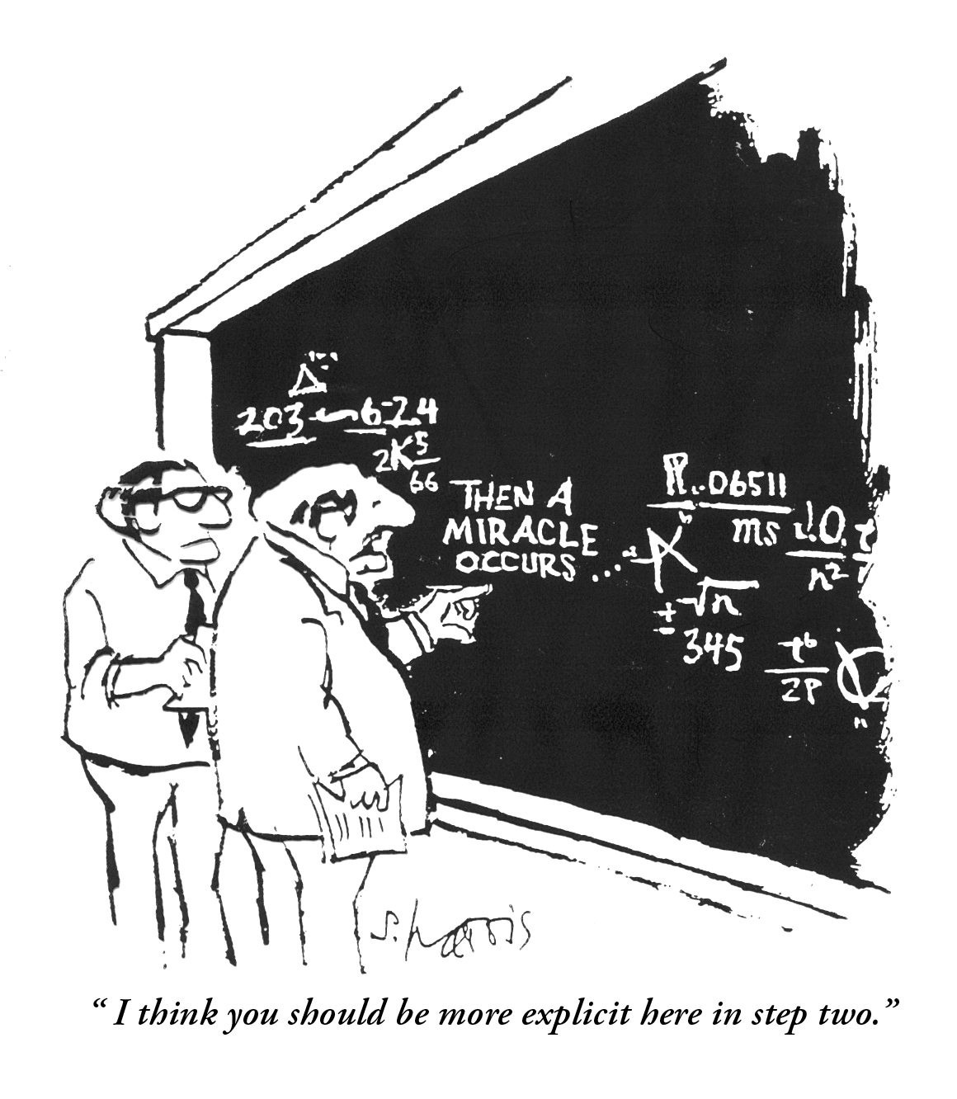

Slide 3
Leadership defined:
the proactive process of influencing others “to act for certain goals that represent the values and motivations—the wants and needs, aspirations and expectations—of both leaders and followers” (Burns, 1978, p. 19)

Slide 4
Leadership:
Nature (Characteristic You Were Born With)
Nurture (Behavior You Can Learn)

Slide 5
Strategic Leadership
Being at the Right Place at the Right Time
And Doing The Right Thing

Slide 6
Leadership is a process of mutual influence and shared responsibility set in context.

Slide 7
Truths About Leadership
Contextually Bound
Can Be Learned
The Harder the Task, The More Complex the Process of Leadership

Slide 8
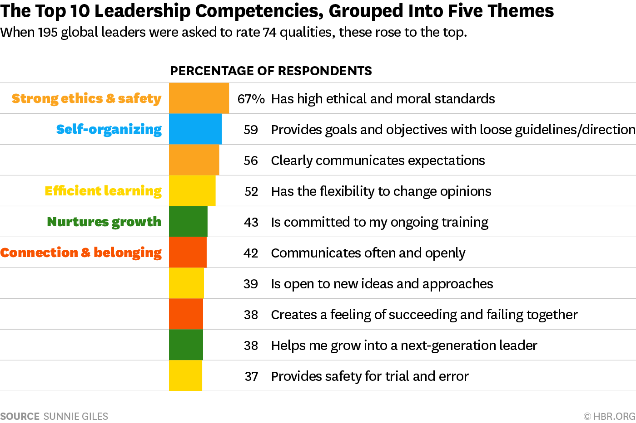

Slide 9
What characteristics are most important in your role? (n=72)
Ability to Advocate (3)
Ability to be a Systems Thinker (3)
Ability to Categorize Needs
Ability to Delegate (2)
Ability to Disseminate Information
Ability to Negotiate
Ability to Prioritize (2)
Accountable (2)
Adaptable
Analytical (3)
Approachable (2)
Articulate (3)
Attentive
Balance
Being a “Cheerleader”
Being a Good Listener (17)
Being an Enforcer
Being Present
Clarity
Collaborative (13)
Communicative (18)
Compassion
Confidence
Consistency (3)
Contemplative (2)
Creative (4)
Credible
Curious (4)
Decisive (3)
Dedicated
Diligent
Diplomacy
Empathy
Empowering
Encouraging
Engaged (2)
Fair (2)
Fiscally Savvy
Flexible (10)
Focused (6)
Generous
Good at Facilitation (3)
Good at Stress-Management
Good Problem Solving Skills (4)
Good Relationship Skills (12)
Good Team Building Skills (2)
Good Time-Management Skills (2)
Honest (4)
Humble (6)
Hungry
Inclusive
Inspiring
Integrity
Kind (2)
Knowledgeable (12)
Managerial
Motivated
Objective
Open-Minded (11)
Optimistic
Organized
Passionate (3)
Patient (7)
Perceptive
Persistent (3)
Persuasive
Positive (3)
Realistic
Receptive
Reflective
Relaxed
Reliable (2)
Resilient (4)
Resourceful
Respectful
Responsive (4)
Self-Driven
Self-Monitoring
Self-Motivated (2)
Sense of Humor (4)
Service Mentality
Steadfast
Strategic thinking
Strong (3)
Supportive (14)
Teamwork (3)
Tolerant
Transparent (2)
Trustworthy
Understanding (5)
Visionary
Willing

Slide 10
What are the Leadership Characteristics That are Important to You in Your Role?
NOW?
In The Future?
How Will You Acquire Them?

Slide 11
MY Essential Characteristics of Leadership
Integrity
Moral Judgement
Courage

Slide 12
Valued Leadership Competencies
Having a clear purpose
Able to navigate complex systems
Able to develop a shared vision for the service delivery system
Able to build trusting relationships
Able to take risks
Able to collaborate

Slide 13
Leaders Must:
Establish and maintain principles that become inherent in the organization they are leading:
rationale environments
clear values
openness to change and innovation
maturity
space for people to grow
momentum effectiveness
stewardship
Bloch, 1996; DuPree, 1992

Slide 14
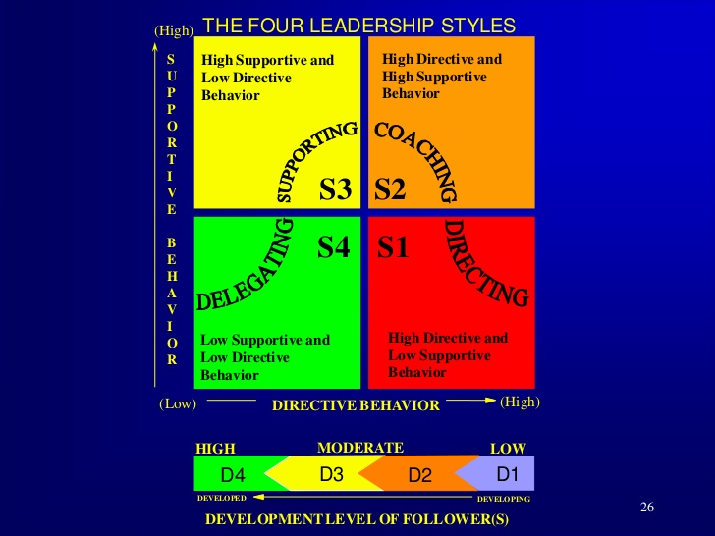

Slide 15
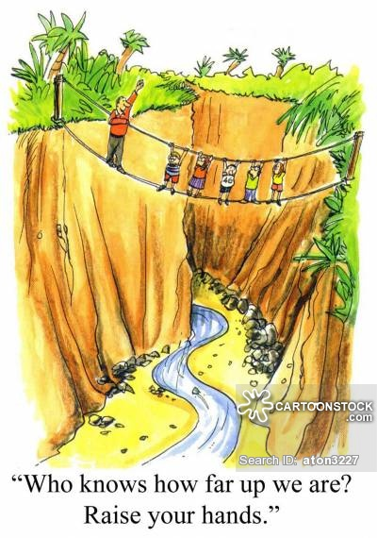

Slide 16
The Five Faces of Leadership

Slide 17
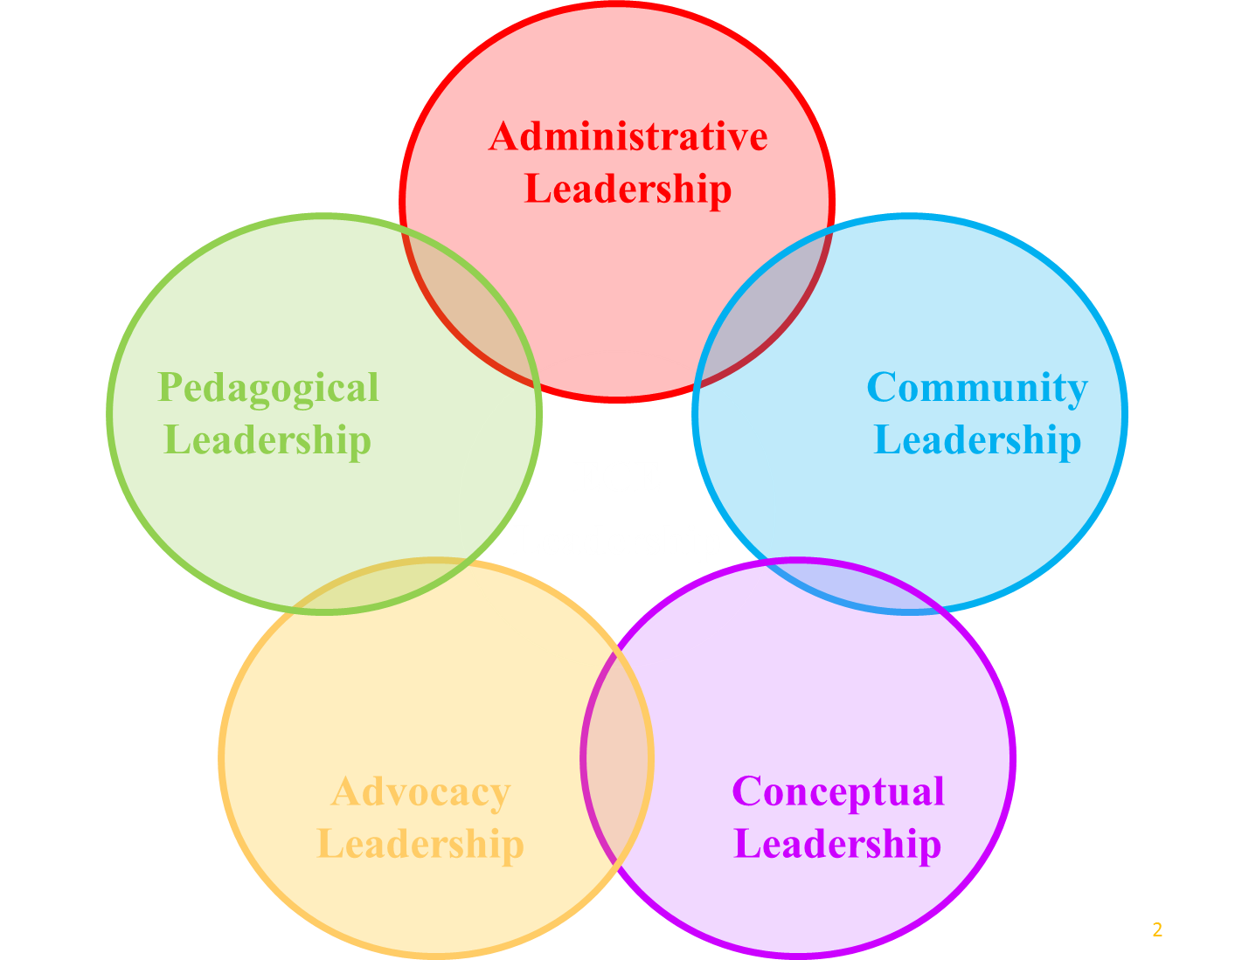
Source: Crompton, D. A. (1997). Community Leadership. In S. L. Kagan & B. T. Bowman (Eds.), Leadership in Early Care and Education (49-55).
Washington, DC: National Association for the Education of Young Children.

Slide 18
The Five Faces of Leadership: Administrative Leadership
Early childhood care and education (ECCE) program can be thought of as a business organization that provides services to children and families
Administrator of the ECCE program is the director
Effective administrative leaders:
  Provide for ongoing learning for staff
  Direct child and family services
  Build internal and external communication networks
  Manage the program’s finances
Directors of early childhood programs are central to program quality
Managers vs. Leaders
  Managers in EC settings focus on the specific details of daily operation
  Leaders engage in reflective, dynamic, value-based planning and organizing
    Provide vision, inspiration, structure, and direction to their colleagues
Source: Crompton, D. A. (1997). Community Leadership. In S. L. Kagan & B. T. Bowman (Eds.), Leadership in Early Care and Education (49-55).
Washington, DC: National Association for the Education of Young Children.

Slide 19
The Five Faces of Leadership:
Community Leadership
ECCE community leaders help the community understand why ECCE is important
Effective ECCE community leaders:
  Show the community that quality ECCE significantly affects children’s later success in school and in life
  Convince other community leaders to place ECCE prominently in the community agenda
  Influence community policies to create quality ECCE programs by outlining what needs to be done
  Assist in securing the human and financial resources needed for quality ECCE programs
Source: Crompton, D. A. (1997). Community Leadership. In S. L. Kagan & B. T. Bowman (Eds.), Leadership in Early Care and Education (49-55).
Washington, DC: National Association for the Education of Young Children.

Slide 20
The Five Faces of Leadership:
Conceptual Leadership
Conceptual leadership is about creating new ideas
Effective ECCE conceptual leaders:
  Think about the field of ECCE as a whole, rather than as individual programs
  “Think together” by collaborating with others in the field
  Are responsive to diverse perspectives
  Look towards the future and consider possibility
  Reach out to other institutions and their leaders, families, and communities
  Seek to impact the social good by considering how ECCE contributes to society
Source: Crompton, D. A. (1997). Community Leadership. In S. L. Kagan & B. T. Bowman (Eds.), Leadership in Early Care and Education (49-55).
Washington, DC: National Association for the Education of Young Children.

Slide 21
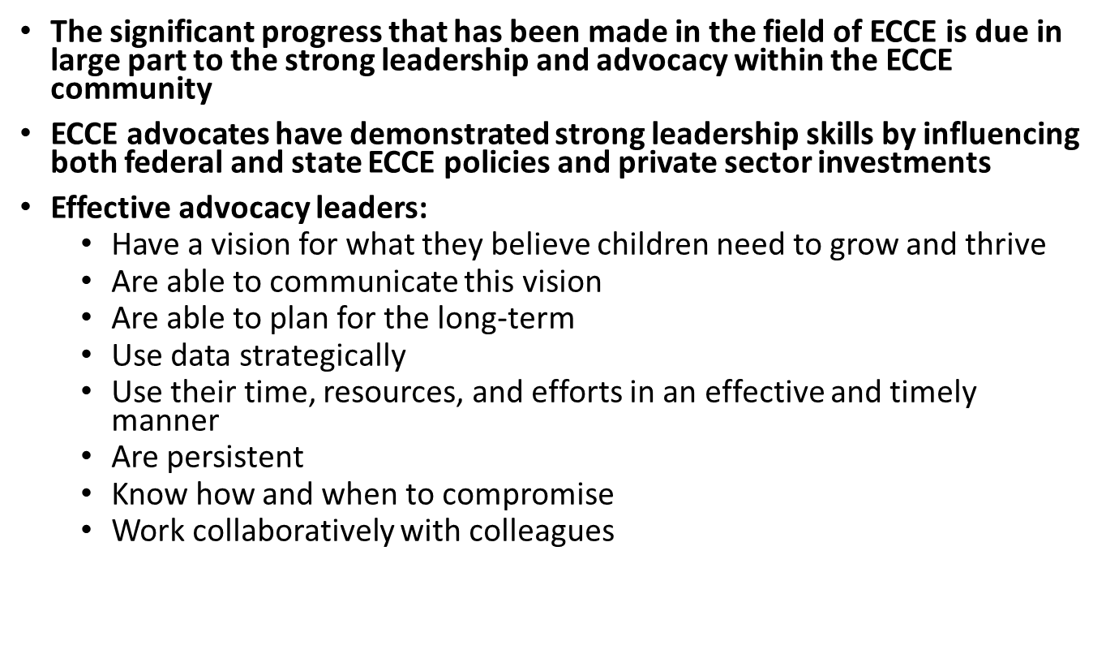
The Five Faces of Leadership:
Advocacy Leadership
Source: Crompton, D. A. (1997). Community Leadership. In S. L. Kagan & B. T. Bowman (Eds.), Leadership in Early Care and Education (49-55).
Washington, DC: National Association for the Education of Young Children.

Slide 22
The Five Faces of Leadership:
Pedagogical Leadership
Effective ECCE pedagogical leaders:
  Achieve and maintain credibility in both the practitioner and research worlds
  Make their ideological assumptions about ECCE and the sources of these assumptions explicit
  Engage in open discussion and exchange with their colleagues by presenting their ideas in public forums and documents
  Help researchers and practitioners understand each others’ perspectives and their contributions to the field of ECCE
  Are able to communicate the views and findings of practitioners and researchers to others involved in field (e.g., families, school boards, etc.)
  Set the pedagogical agenda by maintaining an awareness of the issues in pedagogy
  Identify new developments in pedagogy
Source: Crompton, D. A. (1997). Community Leadership. In S. L. Kagan & B. T. Bowman (Eds.), Leadership in Early Care and Education (49-55).
Washington, DC: National Association for the Education of Young Children.

Slide 24

Point of View
https://www.youtube.com/watch?v=pba_hW8XM_g

