Slide 1
The History of Early Childhood Education, Early Childhood Special Education and Early Intervention for Children with Disabilities and Their Families
CT Leadership Academy
January 29, 2026

Slide 2

Early Childhood Intervention
Early Childhood
Disability
ECI
Maternal and Child Health

Slide 3

Historic Understandings of Disability
Historically, disability was understood within a model that was an extension of the medical model, which viewed health problems as an individual pathology; a problem within the person.
Within such a context, disability was understood as a characteristic of the person; as residing with the person.
  The person was seen as broken, diseased, pathological, atypical, or aberrant; as outside the norm.
  Perhaps unavoidably, people with disabilities were, consequently, associated with numerous negative stereotypes.
Medical-Institutional Paradigm
Community Services Paradigm
Supports Paradigm

Slide 4
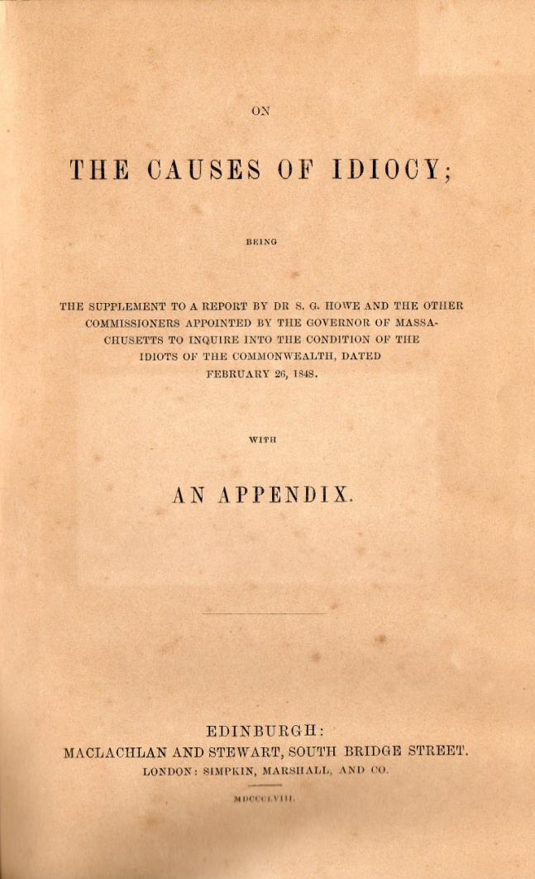

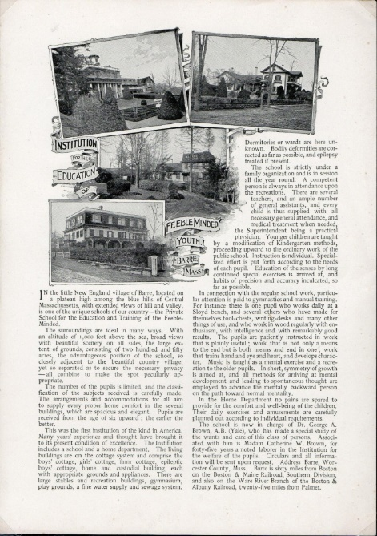

Slide 5
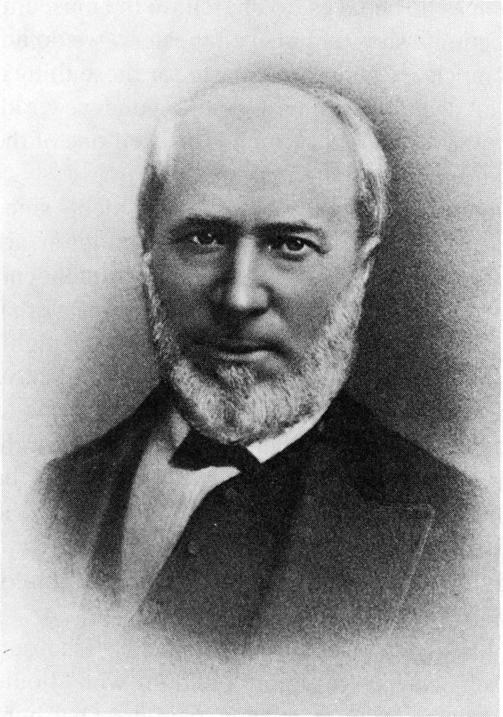
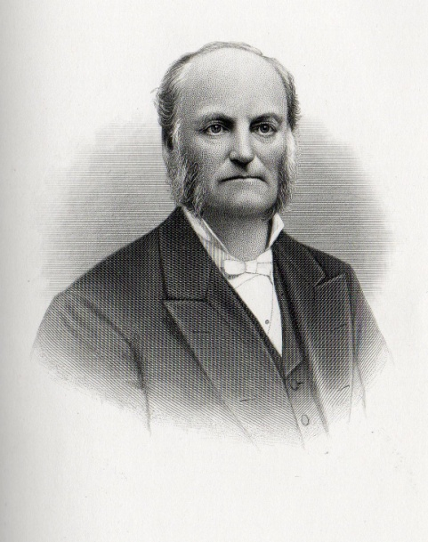
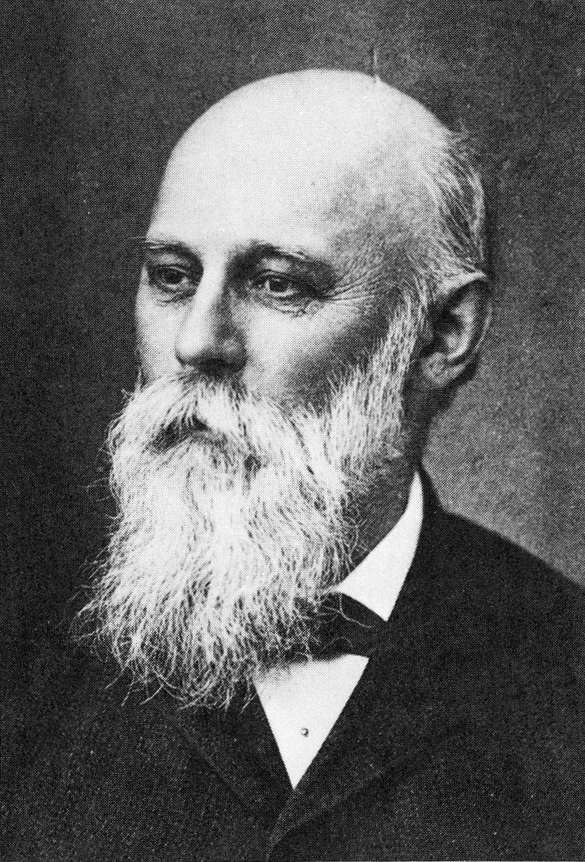

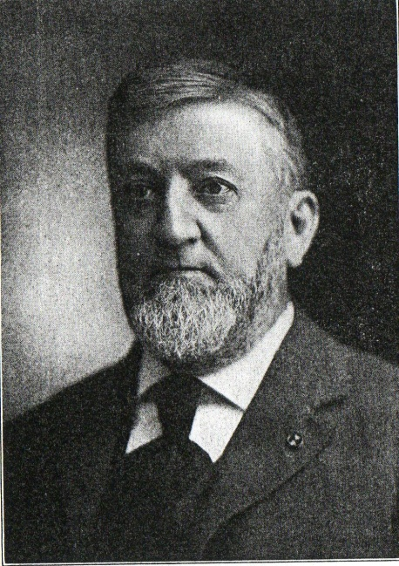
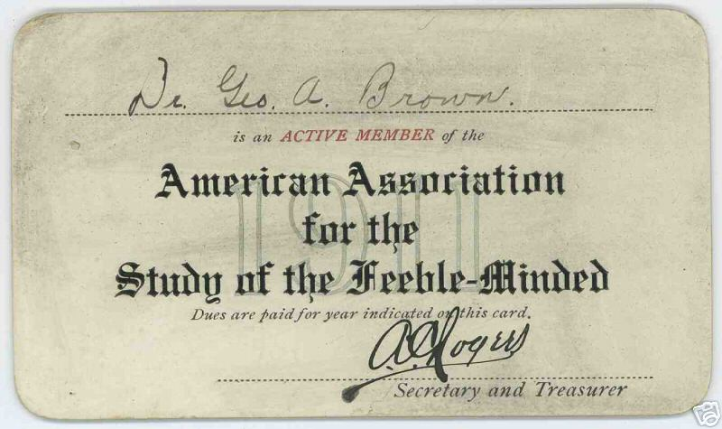
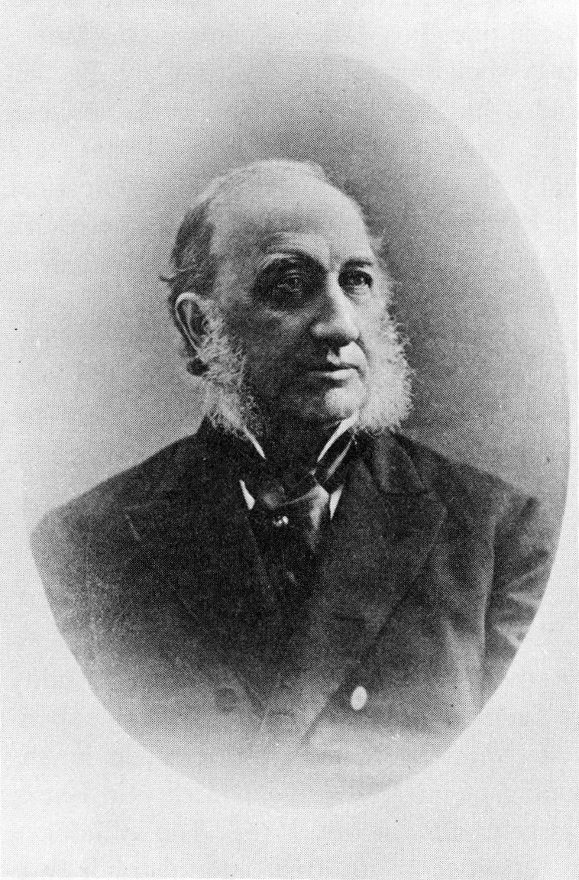
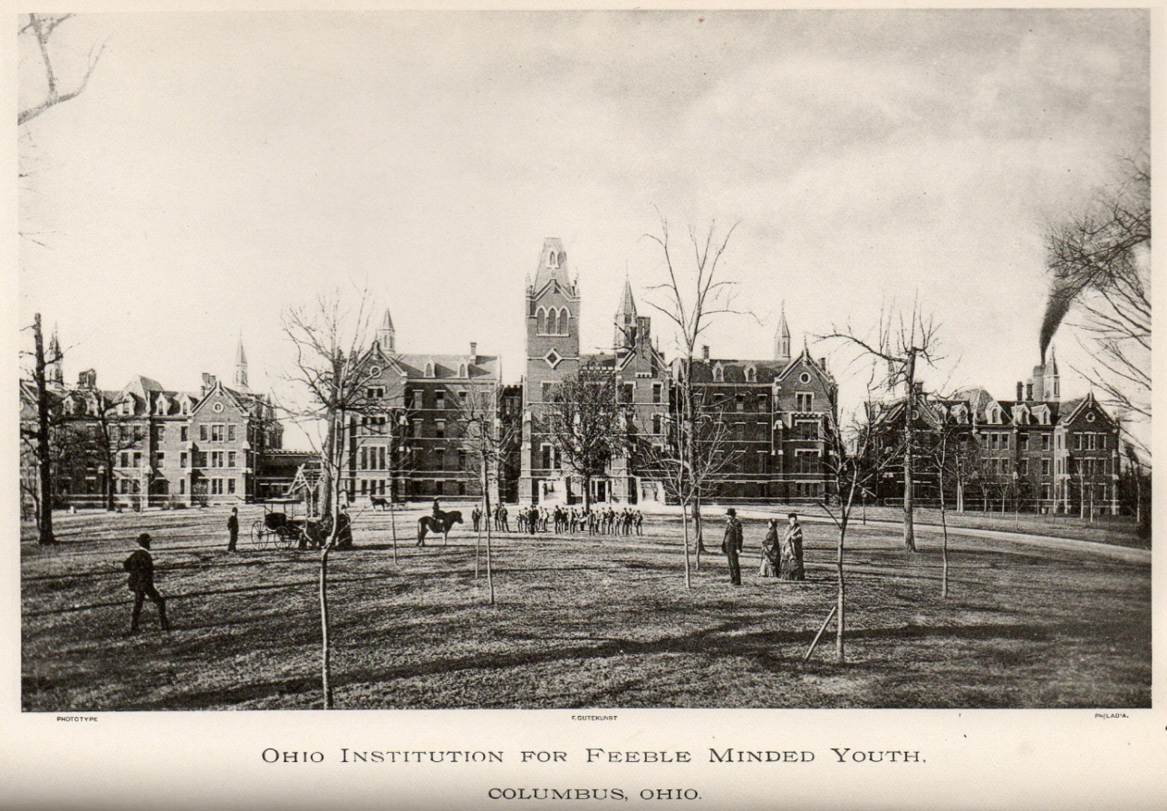
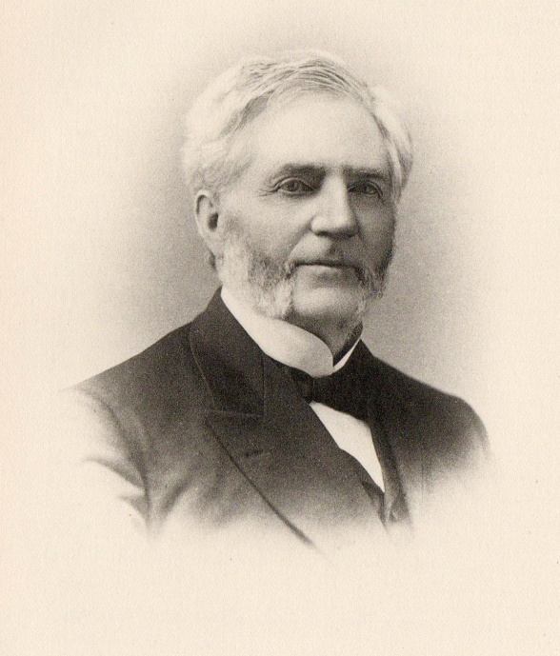
Association of Medical Officers of American Institutions for Idiotic and Feeble-Minded Persons
H. M. Knight, M.D.
President 1879 to 1880
Isaac N. Kerlin, M.D.
President 1891 to 1892
Edouard Seguin, M.D.
President 1876 to 1877
Pennsylvania Training School, Media PA
Charles T. Wilbur, M.D.
President 1880 to 1881
Second Annual Meeting
June 12-15, 1877
Hervey B. Wilbur, M.D.
President 1877 to 1878
George W. Brown, M.D.
President 1881 to 1882

Slide 6
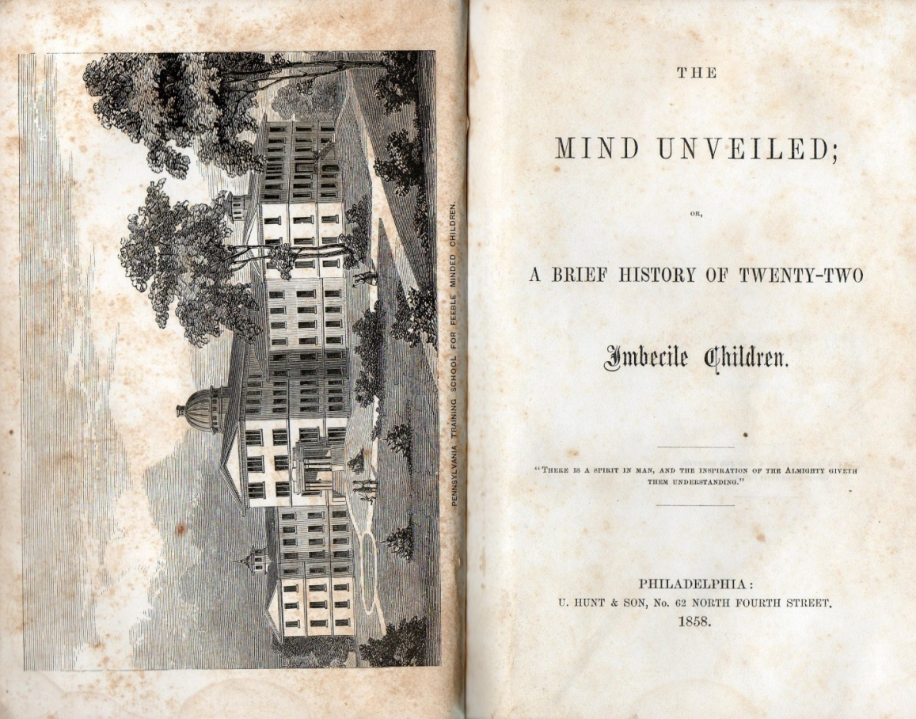
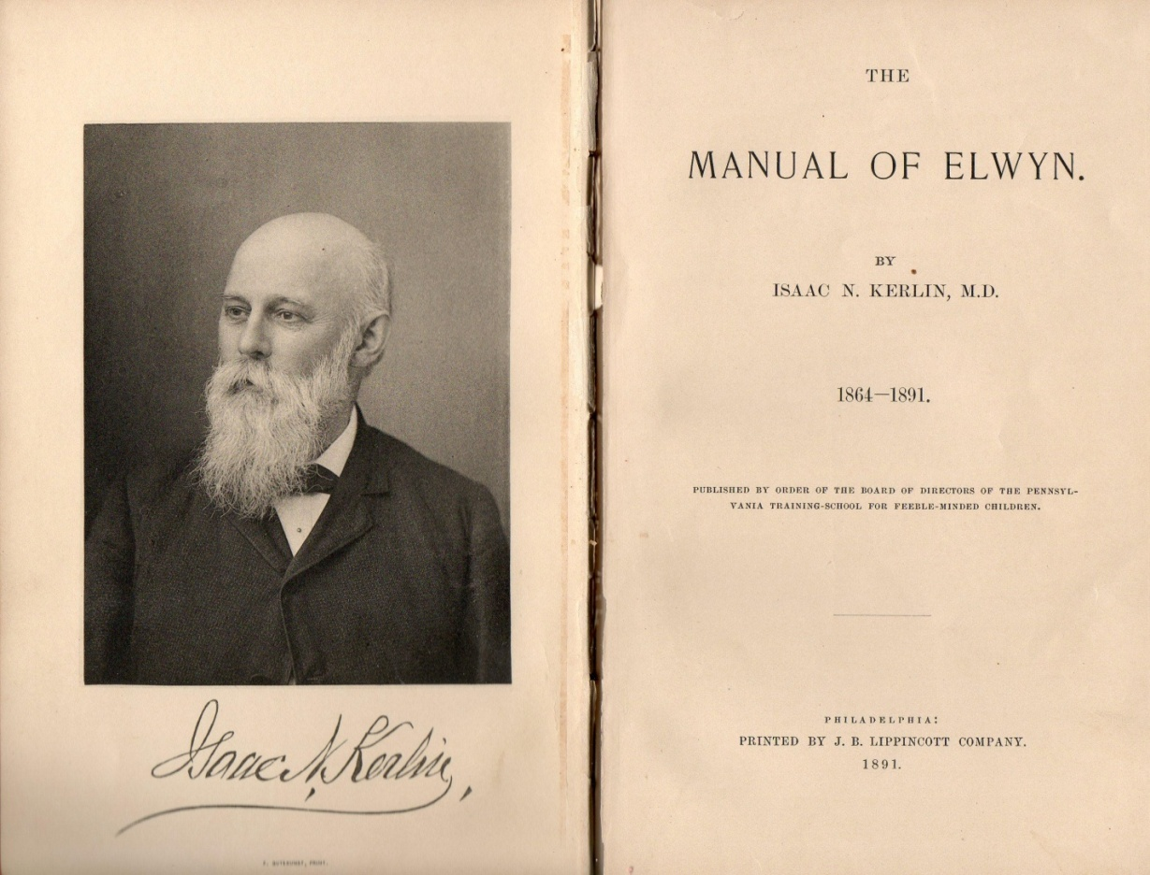

Slide 7
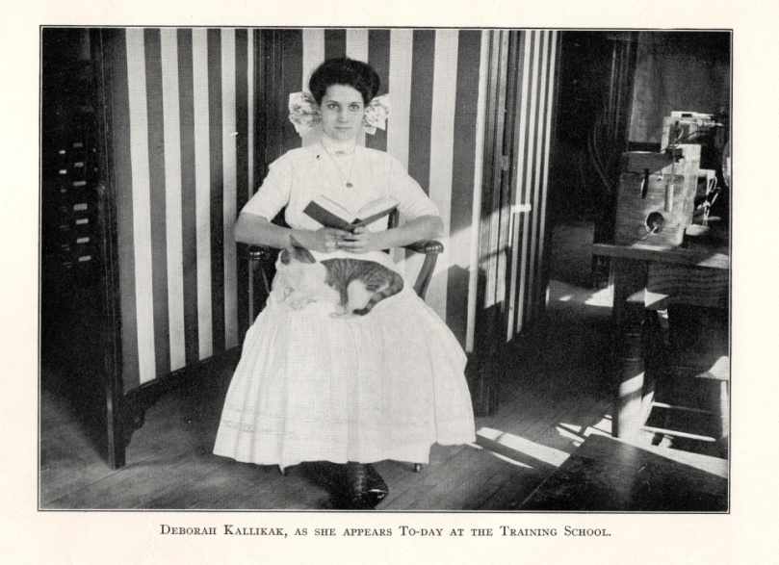
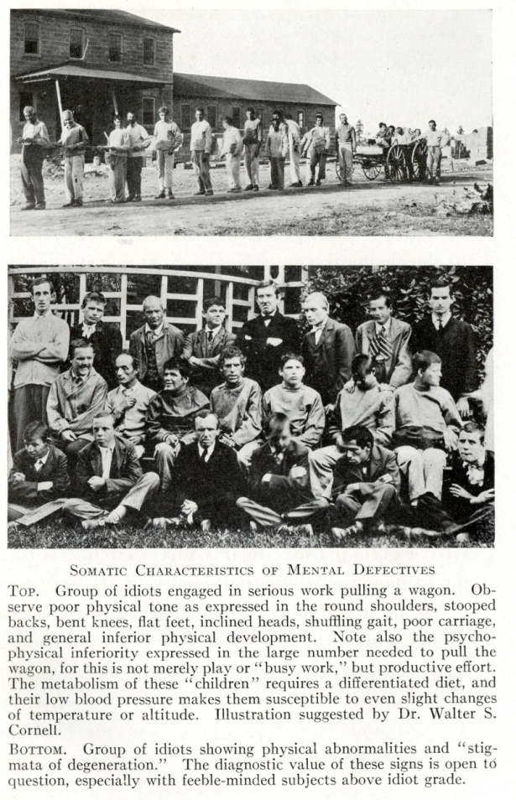
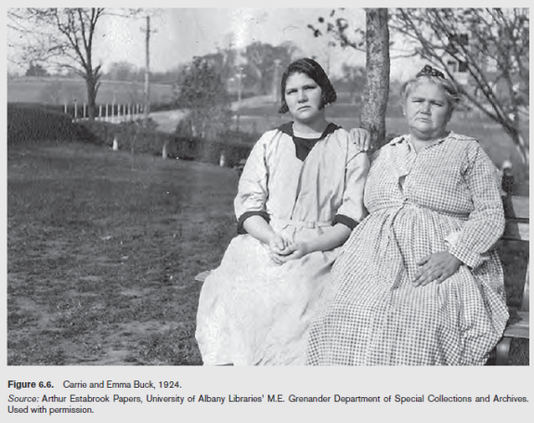
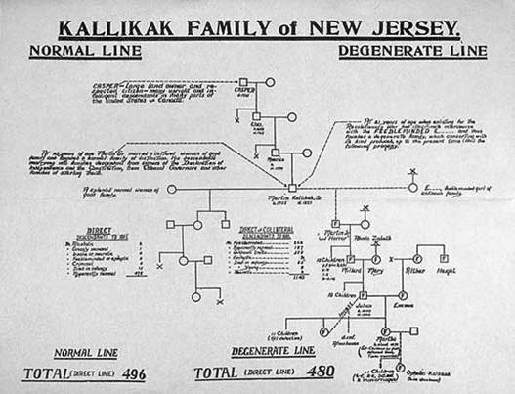
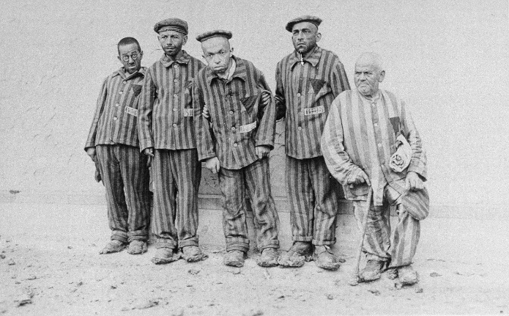
Isolation, Enlargement, and Economization

Slide 8

"a snake pit... the children live in filth…”
“…I think that particularly at Willowbrook, we have a situation that borders on a snake pit, and that the children live in filth, that many of our fellow citizens are suffering tremendously because lack of attention, lack of imagination, lack of adequate manpower. There is very little future for these children, for those who are in these institutions. ….”
Image from Parallels in Time, Minnesota
Developmental Disabilities Council
http://www.mnddc.org/parallels/

Slide 9
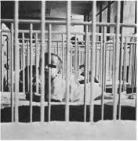

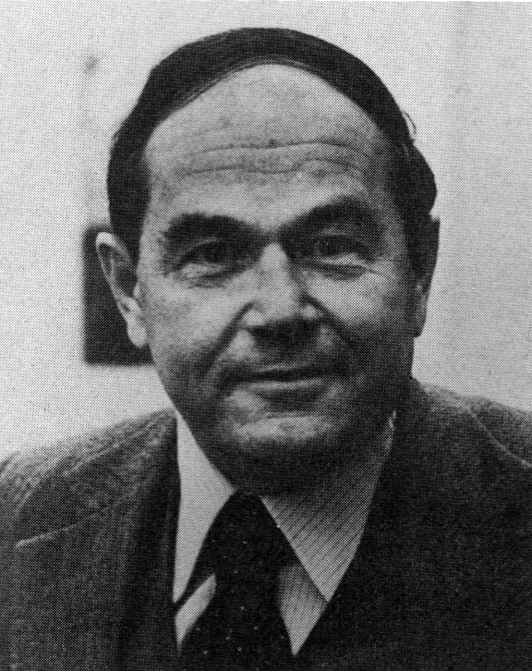
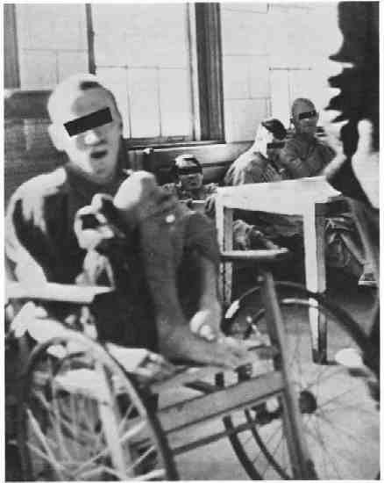
Christmas in Purgatory
Burton Blatt, EdD

Slide 10
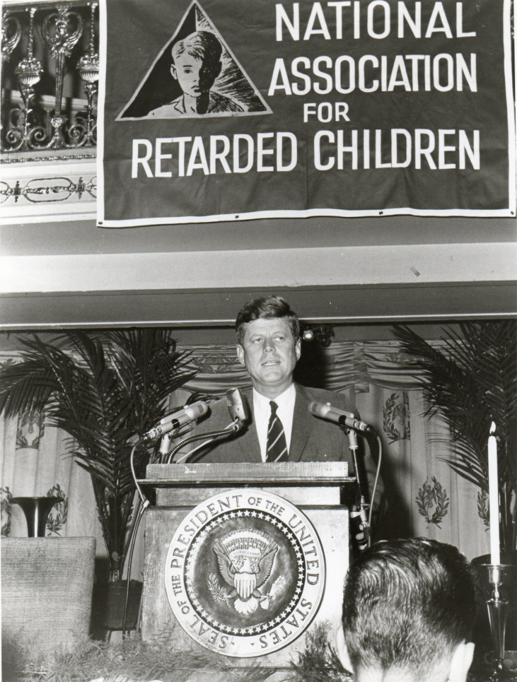
The Parent Movement
President John F. Kennedy gives Eunice Kennedy Shriver the pen he used to sign intellectual disability legislation in October, 1963 (photo from the collection of David Braddock, used with permission).
President Kennedy addresses the 13th Annual Convention Luncheon of the National Association for Retarded Children on October 24, 1963 at the Mayflower Hotel, Washington, DC (photo from the author’s collection).

Slide 11
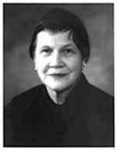
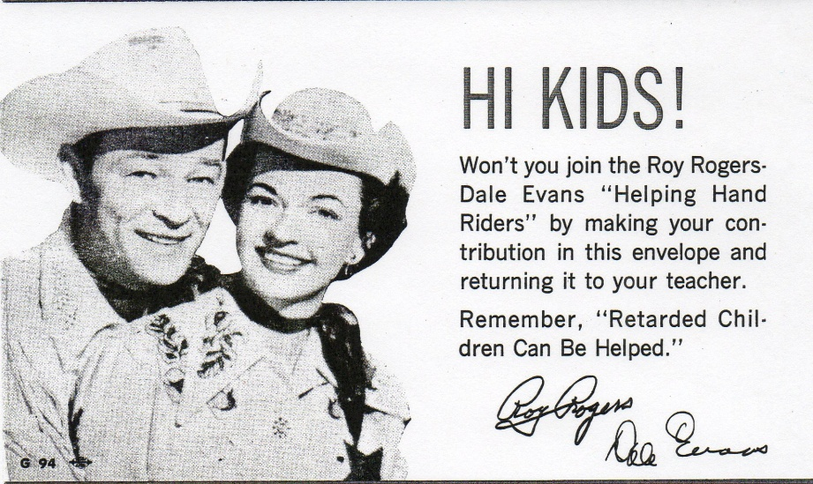
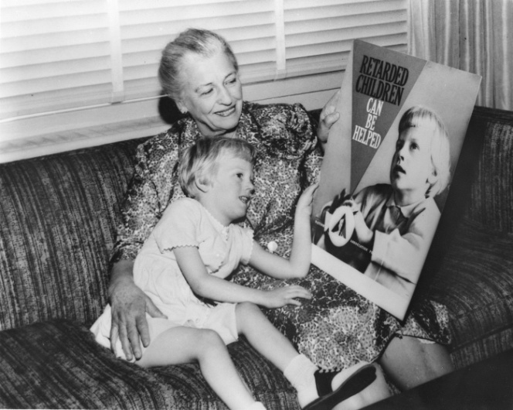
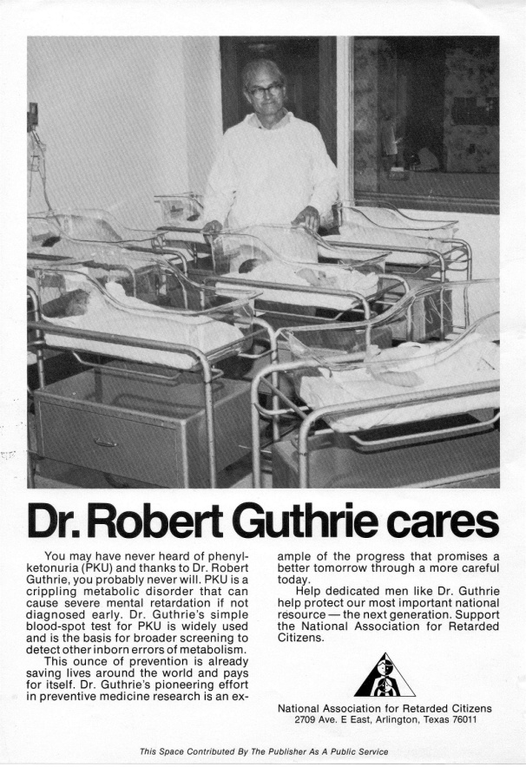
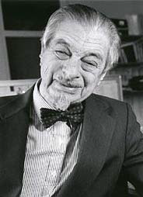


The Parent Movement

Slide 12
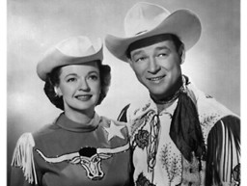

The Parent Movement
Earlier stereotypes of disability replaced with more humane, though still in many ways debilitating, stereotypes.
People with disabilities seen as objects to be fixed, cured, rehabilitated and pitied; as “victims” of their disabling condition, worthy of charity.
  Holy innocents; eternal children
Increased emphasis on “mental age.”

Slide 13

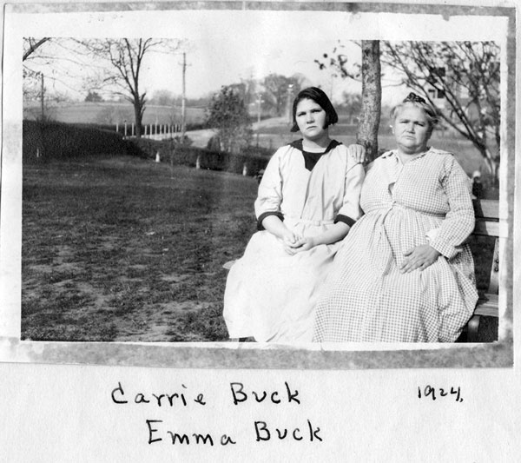

1. Understanding people as different soon becomes construed as inferior, leading to discrimination and maltreatment.

Slide 14
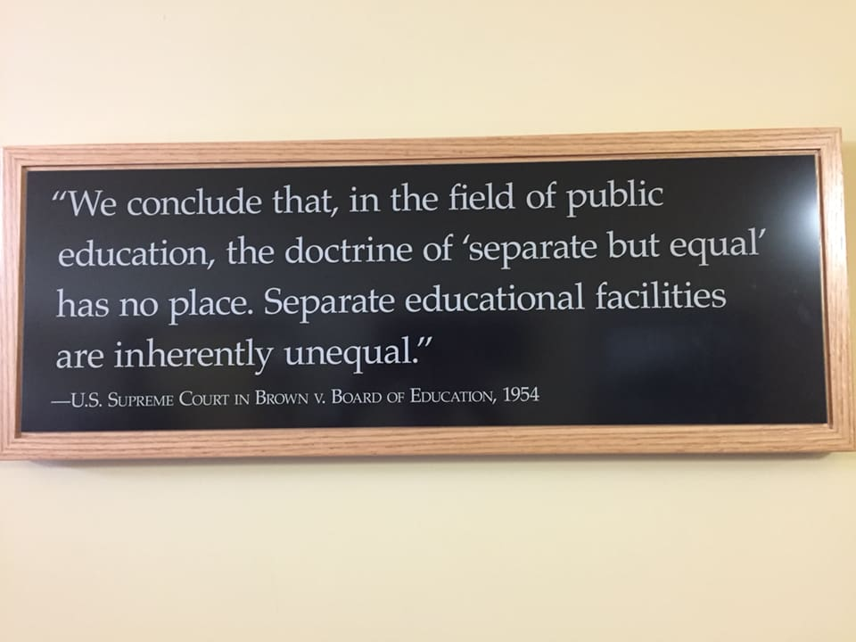
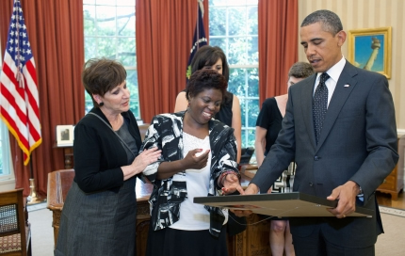
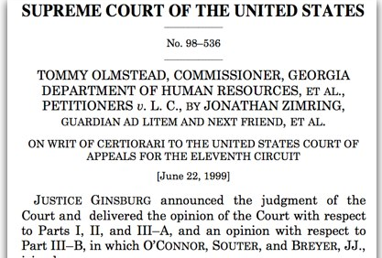
2. Separate is never equal.

Slide 15
3. We are constrained by our own lack of imagination
“… I think that particularly at Willowbrook, we have a situation that borders on a snake pit, and that the children live in filth, that many of our fellow citizens are suffering tremendously because lack of attention, lack of imagination, lack of adequate manpower. There is very little future for these children, for those who are in these institutions. ….”
Image from Parallels in Time, Minnesota
Developmental Disabilities Council
http://www.mnddc.org/parallels/

Slide 16
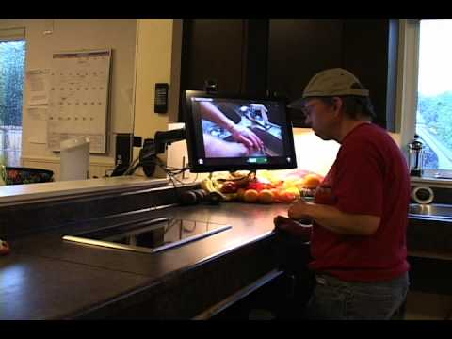


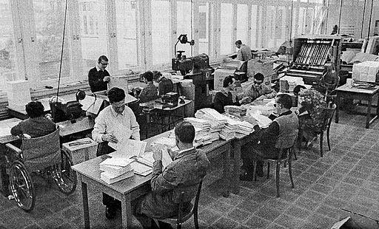


4. We have always been wrong about what we believe people with disabilities can achieve.

Slide 17

5. The injustice committed against people with disabilities throughout time has been to deny them the dignity afforded to persons simply by their status as human beings.
Article 3-General Principles, United Nations a. Respect for inherent dignity, individual autonomy including the freedom to make one’s own choices, and independence of persons;

Slide 18
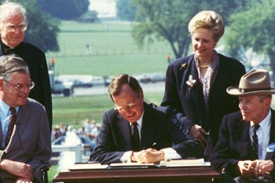
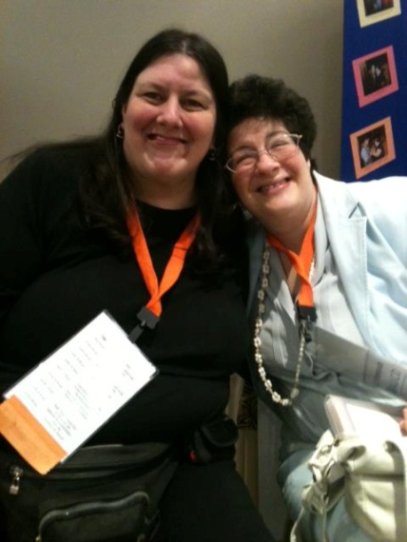
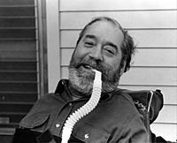


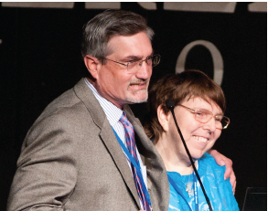
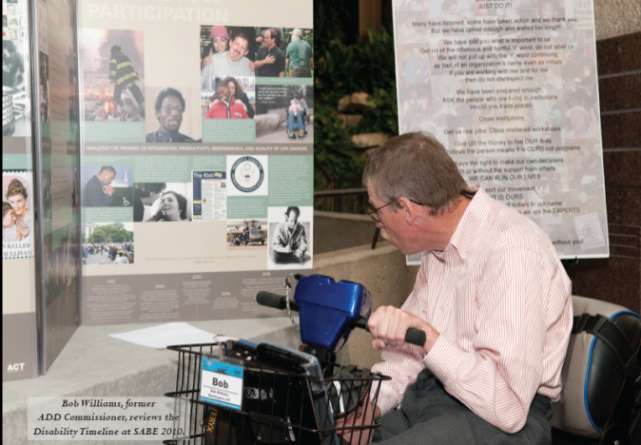
The Self-Advocacy Movement
Ed Roberts
Justin Dart at signing of ADA
Tia Nelis and Elizabeth Weintraub
Bengt Nirje at AAIDD
Robert Williams at SABE
Nancy Ward

Slide 19

Implications of Changing Understandings of Disability
Strengths-based
Part of, and not apart from, typical human functioning
Focus on environment/context, not fixing the person;
Emphasizes supports, not programs
Emphasis on promoting/supporting self-determination.

Slide 20

Supports are resources and strategies that…
promote the interests and causes of individuals with or without disabilities;
enable them to access opportunities, information, and relationships inherent within integrated work and living environments;
results in enhanced interdependence, productivity, community inclusion, life satisfaction, and human functioning.
  In other words, anything that enable a person to live a self-determined life.
Specialized Services
Generic Services
Nonpaid Supports
Family & Friends
Person

Slide 21

Dignity, Autonomy, and Choice
Article 3-General Principles, United Nations a. Respect for inherent dignity, individual autonomy including the freedom to make one’s own choices, and independence of persons;

Slide 22
Inherent Dignity
Article 3-General Principles, United Nations Convention on the Rights of Persons with Disabilities
a. Respect for inherent dignity, individual autonomy including the freedom to make one’s own choices, and independence of persons;
inherent [in-heer-uh-nt]
adjective
existing in someone or something as a permanent and inseparable element, quality, or attribute.
Synonyms
innate, native, inbred, ingrained
dignity [dig-ni-tee]
The state of being worthy or honorable, elevation of mind or character, true worth;
Elevated rank; honorable station; high office;
Quality suited to inspire respect or reverence; loftiness and grace, impressiveness; stateliness.
From dignus [Latin] meaning worthy

Slide 23

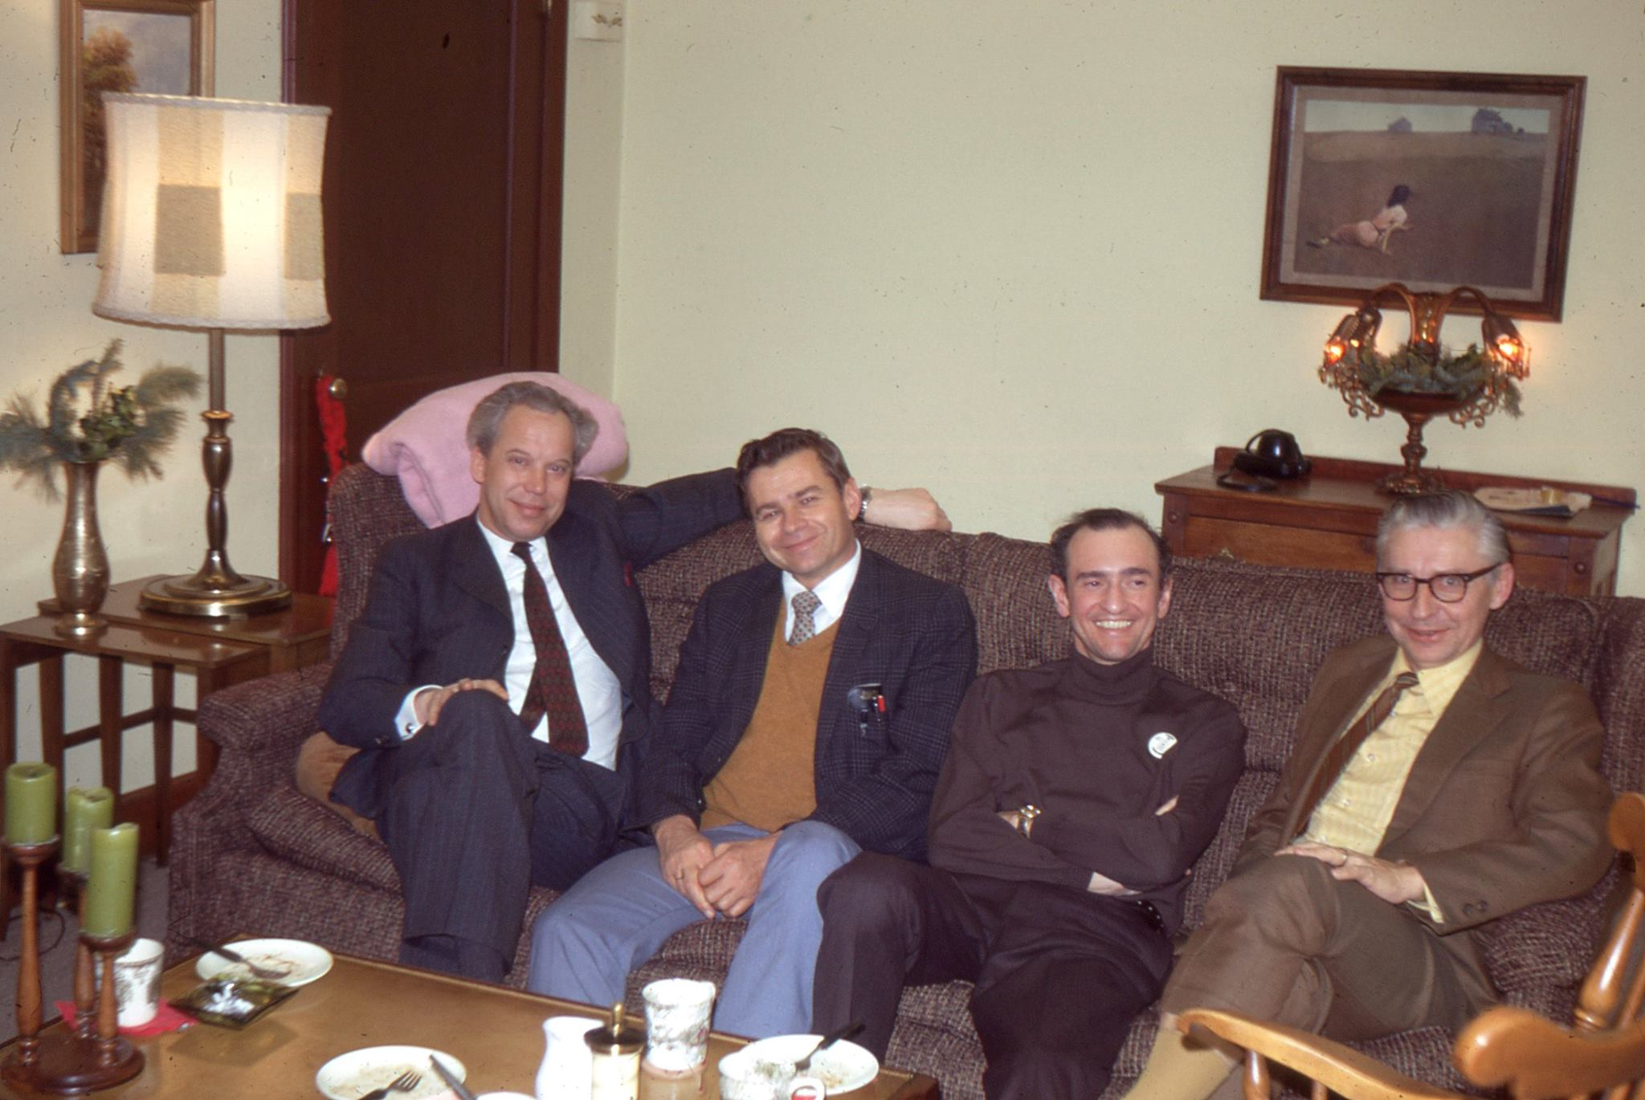
The Principle of Normalization in
Human Services

Slide 24
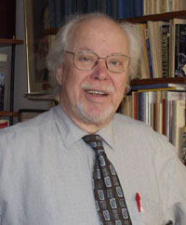
The Right to Self-Determination
Bengt Nirje (1972)
One major facet of the normalization principle is to create conditions through which a disabled person experiences the normal respect to which any human being is entitled. Thus, the choices, wishes, desired, and aspirations of a disabled person have to be taken into consideration as much as possible in actions affecting him. To assert oneself with one’s family, friends, neighbors, co-workers, other people, or vis-à-vis an agency is difficult for many persons. It is especially difficult for someone who has a disability or is otherwise perceived as devalued. But, in the end, even the impaired person has to manage as a distinct individual, and thus has his identity defined to himself, and to others, through the circumstances and conditions of his existence. Thus, the road to self-determination is indeed both difficult and all-important for a person who is impaired.

Slide 25
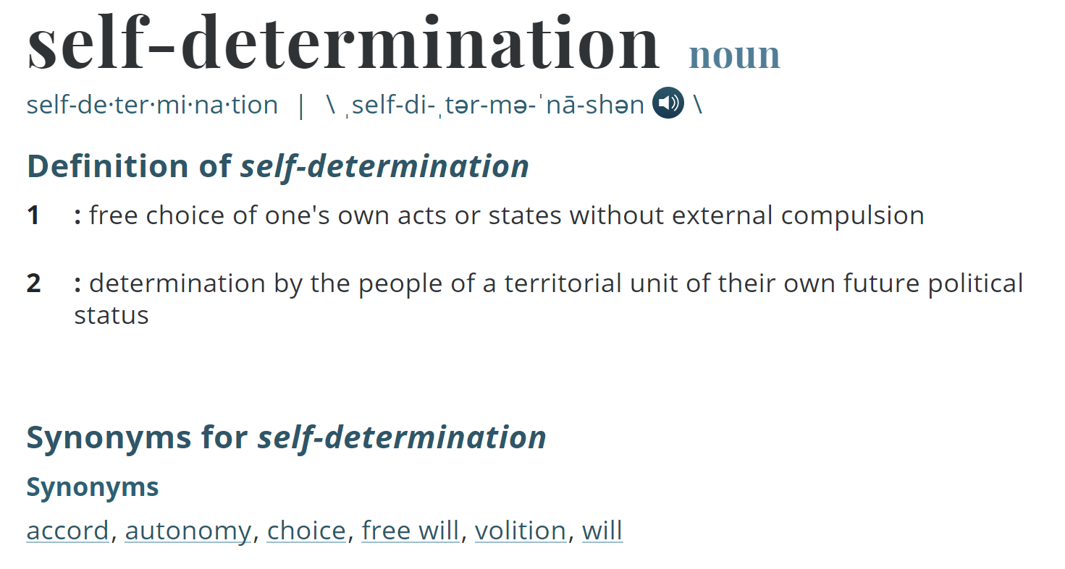
Self-Determination and Autonomy

Slide 26
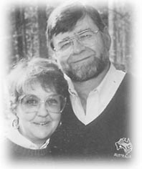
The Dignity of Risk
Robert Perske (1972)
The world in which we live is not always safe, secure and predictable....
We must work to develop every human resource within us in order to prepare for these days.
To deny any person their fair share of risk experiences is to further limit them for healthy living. (p. 199)

Slide 27

Self-Determination and Determinism
The philosophical doctrine of determinism posits that actions are caused by events or natural laws that precede or are antecedent to the occurrence of the action. Behavior, then, is governed by these other events or natural laws.

Slide 28
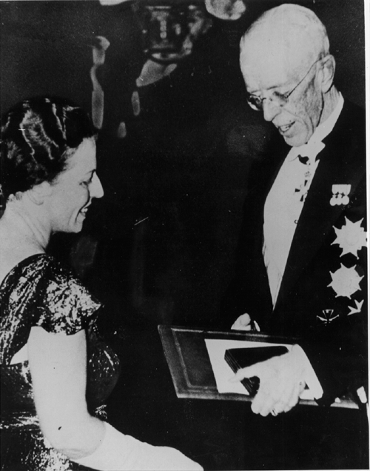
Pearl S. Buck,
1932 Pulitzer Prize, 1938 Nobel Prize
"none who have always been free can understand the terrible fascinating power of the hope of freedom to those who are not free."

Slide 29
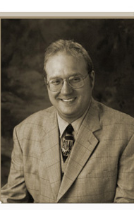

Self-Determination: Dignity, Respect, Equality…
"People with autism should
be treated with the same dignity,
respect, and equality as people
without autism.”
Jean-Paul Bovee
"We don't have to be told what self-
determination means. We know it is just
another word for a life filled with rising
expectations, dignity, respect and
opportunities.“
Robert Williams

Slide 30
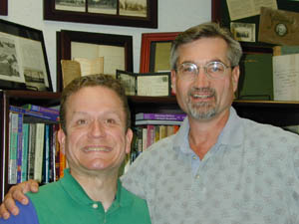
We Are, All of Us, In the Dignity Business

Slide 31
Early Childhood

Slide 32
If you treat an individual as he is he will stay as he is, but if you treat him as he ought to be, and could be, he will become what he ought to be and could be.
~ Goethe

Slide 33
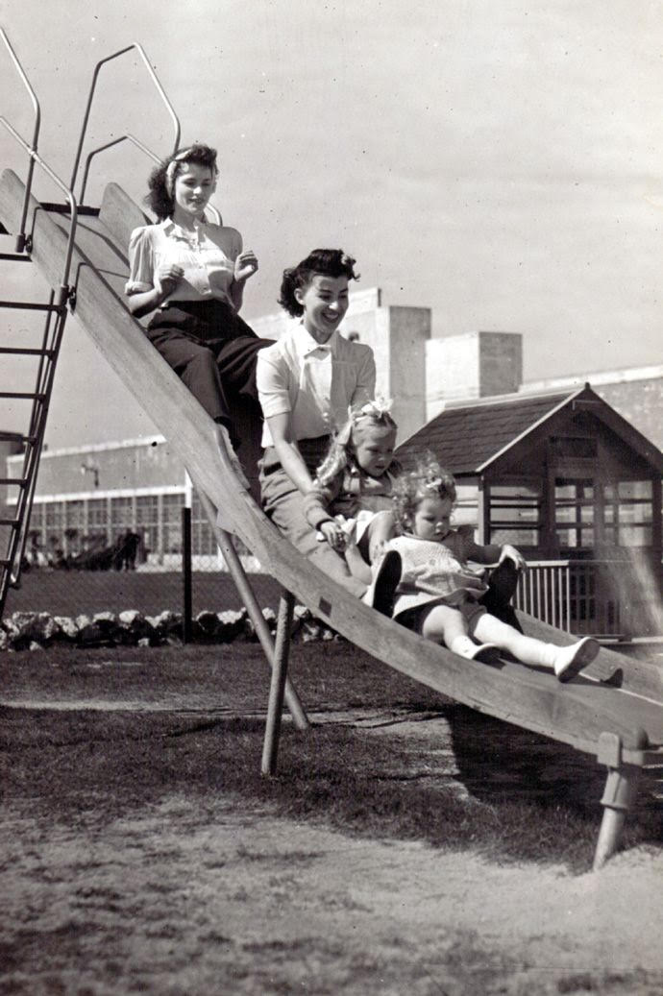
The Early Beginnings of Early Childhood Education
Kindergartens established in the late 1800s
Nursery Schools established in the early 1900s
In 1927, the National Committee on Nursery Schools recommended a 4 - year college degree for nursery school teachers
During the Great Depression and World War II – Women worked outside of the home – Work Progress Administration (WPA) -1933 supported Nursery Schools
Women’s equity movement - The Equal Pay Act of 1963 and Titles VII and IX of the Civil Rights Act of 1964 legislated federal equal rights for women and girls in education and employment including growth in childcare opportunities
Families started preschools for children with disabilities under national and local organizations

Slide 34

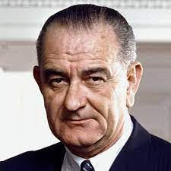
Early Childhood Education Policy
The early objective of federal policy was the stimulation of local services and model practices to improve outcomes for children living in poverty and children with disabilities
1964 - The U.S. Congress passed and President Johnson signed the Economic Opportunity Act which included the Head Start Program - Johnson’s War on Poverty
1972 - The Head Start required the programs to enroll 10% of children with disabilities

Slide 35
Early Intervention and Early Childhood Special Education = Early Childhood Intervention

Slide 36

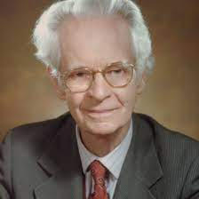
Historical Perspectives on Research (1800s-1930s)
Jean Marc Gaspard Itard – Learning is influenced by the environment rather than primarily by genetics
Edouard Seguin –Identifying individual strengths and weaknesses to inform intervention
Arnold Gesell – Maturation and development are determined biologically- the impact of experiences on the development is minimal
John Watson, Edward Thorndike, B. F. Skinner, Clark Hull, Kenneth Spence – Behaviorist theory – development is primarily a result of the experience and environment

Slide 37
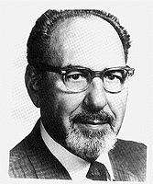
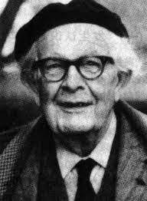
Historical Perspectives on Research (1930s-1970s)
Harold Skeels and H.B. Dyes – Changes in the cognitive development influenced by a change in environment
Samuel Kirk – Affects of preschool experience on IQ
Benjamin Bloom; J. McVicker Hunt; Rene Spitz – The relationship of a stimulating environment to the development of a child
Jean Piaget –Biological and experiential influences on child development
Arnold Sameroff and Michael Chandler –Influence of adult – child and environmental interactions on child development

Slide 38

Historical Perspectives on Research (1970s-1990s)
Bengt Nirje/Wolf Wolfsenberger – Normalization principle
Urie Bronfenbrenner – Ecological model of child development; children develop in systems that influence them
Michael Guralnick – Changed research question from efficacy to: what works, for which children and under what conditions

Slide 39

Current Day Researchers – Interactive Activity
Breakout Group Discussion Questions
  What does scientifically based interventions mean?
  What constitutes evidence?
  How do you know if what you are doing has robust or promising evidence to improve outcomes for infants and young children?
Breakout Sessions – 10 minutes
Report Out in Large Group

Slide 40
Education Legislation - Disabilities
1966 - Elementary and Secondary Education Act: Bureau of Education for the Handicapped (P.L. 89-750)
1968 - Handicapped Children’s Early Education Assistance Act (P.L. 90-538)
1972 - Amendments to the Economic Opportunity Act to extend Head Start services to children with disabilities (P.L. 92-424)

Slide 41
EHA – State Implementation Grants
1976 - BEH created a State Implementation Grant (SIG) program for state planning to expand services for young children with disabilities
States competed for the State Implementation Grants that included activities such as need assessments, planning groups, disseminating research findings about effective services and models, providing personnel development, and developing program and personnel standards and guidelines and data collection
SIGs influenced future policy development

Slide 42

Early ECSE and EI Policy – HCEEP
The body of research, demonstration, outreach and research programs, scientific literature, and a national network of advocates that resulted from the HCEEP program led to:
knowledge of the efficacy of early intervention;
advocacy groups that included family members, researchers, and service providers
ECSE teacher certification programs
Amendments to P.L. 94-142 to mandate preschool
services and establish a Birth to Three program

Slide 43
HCEEP Expansion
1977 - BEH developed research institutes within HCEEP - homebased services, inclusive/typical classroom services, instructional and assessment practices, and methods of identifying and intervening with children at risk for disability
1983 - Outreach projects were supported to disseminate the innovative models from the demonstration projects to states and locals with the goal of implementing the effective models on a large scale and with state and local resources.

Slide 44
And More….
1975-Education for All Handicapped Children’s Act (94-142)
1986- Amendments to EHA (P.L. 99-457)
1990-The Americans with Disabilities Act (P.L.101-336)
1990-Amendments to EHA changed to Individuals with Education Assistance Act ( P.L.101-476)
2004-Amendments to IDEA (P.L.108-446)
2015-Every Student Succeeds Act (P.L. 114-95)

Slide 45
EHA Principles
Zero Reject
LRE
Nondiscriminatory Testing
IEPs
Due Process for Families

Slide 46
1986 EHA AMENDMENTS
required states to provide a free and appropriate public education to preschoolers (Section 619 of Part B) and provided incentives for serving infants and toddlers and their families (Part H).

Slide 47
P.L. 99-457 Early Childhood Legislation for Children With Disabilities and Their Families
1986 - P.L. 99-457 early childhood legislation for young children with disabilities and their families was passed by the U.S. Congress
Amendments created Part B, Section 619 for preschool-aged children (three through five years) with disabilities and a voluntary Part H program (now Part C) for infants and toddlers (birth through age two) with disabilities or at risk for disabilities

Slide 48
IDEA-PART C; Sec. 631 FINDINGS AND POLICY
Findings.--Congress finds that there is an urgent and substantial need–
to enhance the development of infants and toddlers with disabilities, to minimize their potential for developmental delay, and to recognize the significant brain development that occurs during a child's first 3 years of life;
to reduce the educational costs to our society, including our Nation's schools, by minimizing the need for special education and related services after infants and toddlers with disabilities reach school age;

Slide 49
IDEA-PART C; Sec. 631
FINDINGS AND POLICY (cont.)
to maximize the potential for individuals with disabilities to live independently in society;
to enhance the capacity of families to meet the special needs of their infants and toddlers with disabilities; and
to enhance the capacity of State and local agencies and service providers to identify, evaluate, and meet the needs of all children, particularly minority, low-income, inner city, and rural children, and infants and toddlers in foster care.

Slide 50
IDEA for Infants, Toddlers and Young Children and Their Families
Part C
Choice of Lead Agency
IFSP
Natural Environments
Service Driven
Personnel
Part B
Education Lead Agency
IEP
Least Restrictive Environment
School Driven
Personnel

Slide 51
Implications for Services
Family-Centered Practices
Collaboration/Teaming
Natural and Inclusive Learning Opportunities
Measurable and Functional Outcomes

Slide 52
Early Intervention Practice
Family Centered
Collaborating
and Teaming
Collaborating and Teaming
Learning and Development Outcomes
Family/
Community
Activity Settings
Learning
Opportunities
And Instruction
Natural and Inclusive Early Childhood Environments

Slide 53
Current ECI Systems Thinking

Slide 54

Developmental Systems Model

Slide 55
History of Our Systems Efforts: Ovals or Silos

Slide 56


Slide 57
Elements of Change
Where are we now?
Where do we want to be?
What do we need to do to get from here to
there?

Slide 58

Goal Setting
“Can you tell me please which way I ought to go from here?”
“That depends a good deal on where you want to go to,” said the Cat.
“I don’t much care where,” said Alice.
“Then it doesn’t matter which way you walk,” said the Cat.
Lewis Carroll
Alice’s Adventures in Wonderland

Slide 59
Action Plan
Goals/Objectives | Strategy | Persons Responsible | Timeline | Completion | Evaluation
GOAL 1.
Objective 1.
Objective 2.
Objective 3.
GOAL 2.
Objective 1.
Objective 2.
Objective 3.
GOAL 3.
Objective 1.
Objective 2.
Objective 3.

Slide 60
What is an Action Plan?
An action plan is a document that outlines specific steps that need to be completed for the group to accomplish its mission and/or vision. Action plans should include the following information:
Goal(s), objective(s), and action steps
Criteria for Success
Each action plan should be achievable in one year.
Person responsible for each action step
Target initiation date and deadlines for each action step
Outcomes

Slide 61
Start with a Smart Goal
S
Specific goals are well defined and clear on what needs to be accomplished.
M
Measurable goals enable you to evaluate whether the goal was achieved or not.
A
Attainable goals are realistic about what is possible given the availability of resources, knowledge, and time.
R
T
Relevant goals are important to you and will make an impact on achieving your larger outcome.
Time-Bound goals lock goals into a specific timeframe and specify when they will be completed by.

Slide 62
Action Plan
Goals/Objectives Activities | Person(s) Responsible | Resources Needed | Outcome | Timelines | Criteria for Success
GOAL 1.
Objective 1.1
Activity 1.1.1.
Objective 1.2.
GOAL 2.
Objective 2.1.
Objective 2.2
Objective 2.3.
GOAL 3.
Objective 3.1
Objective 3.2
Objective 3.3

Slide 63
Action Plan Evaluation Tool
Criteria | Yes | No | Improvements Needed:
Value: Objectives in the plan are clearly and directly related to the goal (e.g., development of CSPD).
Value: Activities in the plan target the system at multiple levels (e.g., state & local administration, providers, practitioners, service recipients)
Value: The plan addresses most of the elements of quality in the CSPD framework
Value: Activities in the plan, when completed, can reasonably be expected to result in achieving the objective
Ethical: Activities in the plan include clearly identified feedback loops (e.g., eliciting stakeholder input; providing information; seeking feedback)
Ethical: Criteria (e.g., will include these elements; will address these issues; will meet this standard) and purpose(s) (e.g., in order to…; to be used by…) are clearly stated in objectives and select activities
Feasibility: Activities in the plan are logical in sequence
Feasibility: Timelines are realistic, and the plan is feasible given the time and resources
Measurable: Progress is documented at least monthly, and the plan is revised as necessary based on accomplishments, unanticipated events, performance data, feedback, and so forth
Measurable: The plan identifies measurable results/outcomes that are credible and feasible given the scope of the plan
Timing: Action plans are complete, including timelines, dates, and individual responsibilities and assignments

Slide 64
Strategic Plan Work Plan
Goals/Objectives | Strategy | Persons Responsible | Timeline | Completion | Evaluation
GOAL 1.
Objective 1.
Objective 2.
Objective 3.
GOAL 2.
Objective 1.
Objective 2.
Objective 3.
GOAL 3.
Objective 1.
Objective 2.
Objective 3.

