Slide 1
Building a Partnership Between Birth to Three and Child Care Providers
Karen Galvin and Ashley Slattery

Slide 2
Goal
Improve the systems of support offered by Birth to Three to child care providers in the community.
Birth to Three lead agencies and programs will partner with the OEC to have a more streamlined approach to identify developmental concerns and increase confidence in referring families for evaluations.
Birth to Three will create a set of resources available specifically to childcare centers to increase the number of referrals coming from daycare centers from 2% to 10%.
Notes:
Birth to Three lead agencies and programs will partner with the OEC to have a more streamlined approach to identify developmental concerns and increase confidence in referring families for evaluations.

Slide 3
Steps to Implementation
1) Identify specific areas for improvement
2) Investigate any other programs currently in place
3) Develop a suggested program protocol for daycares to implement, which includes education, screening and tools to facilitate conversations with parents.
4) Follow-up in 6 months and 12 months to determine effectiveness
Notes:
The goal is statewide, consistent use of the programs

Slide 4
Step 1. Identifying an Area of Need
•255 Birth to Three referrals were made from childcare centers in 2024, making up only 2% of our total referrals (Child Find)
•A state survey documented that of 537 childcare providers, 240 had no experience caring for a child with special needs (Bruder, 1998).
•A review of early detection procedures in community settings found that routine screening increased overall referral rates, and that these efforts were successful even in non medical settings such as daycare centers [Daniels, Halladay, Shih, Elder, & Dawson, 2014]
Notes:
This doesn’t take into account families who refer based on the recommendations.

Slide 5
Expanding on the Data
•We created a 10-question survey to be distributed to child care centers across the state of CT
•We distributed a small sample of surveys to child care centers in 7 towns to collect preliminary data
Ultimate goal would be to implement an anonymous, online survey, through the OEC, covering every child care center in the state, to yield more accurate results
Notes:
Results may be skewed due to small population and birth to three providers giving the surveys
Goal would be to cover every town and childcare center in CT

Slide 6
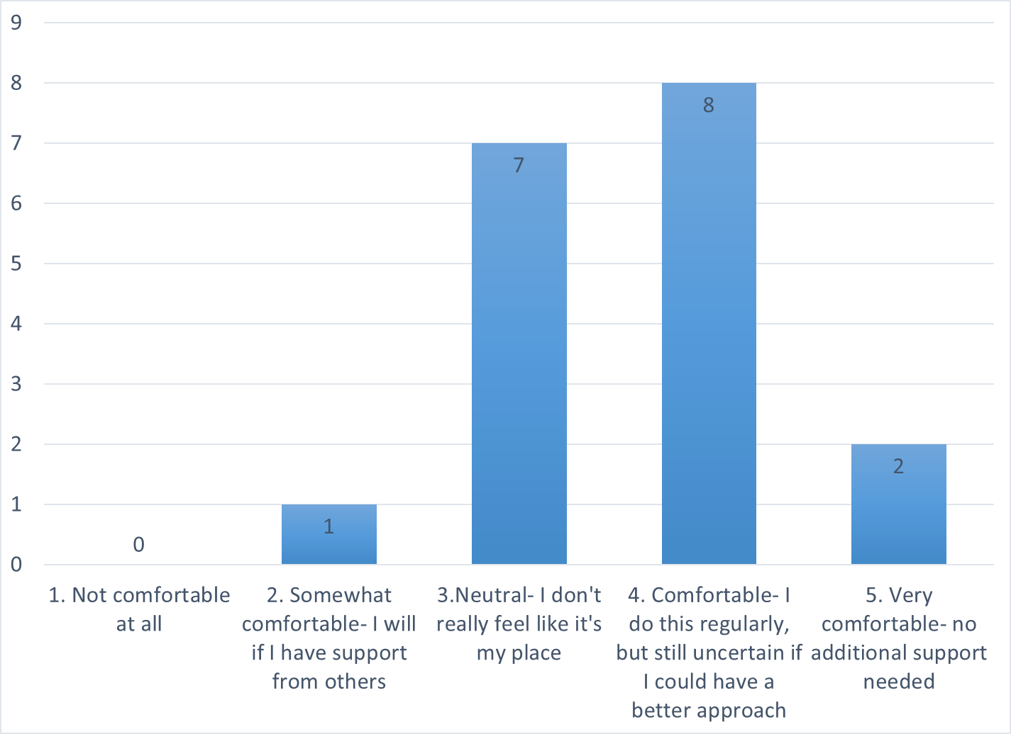
How comfortable are you talking to a family about their child’s development?

Slide 7
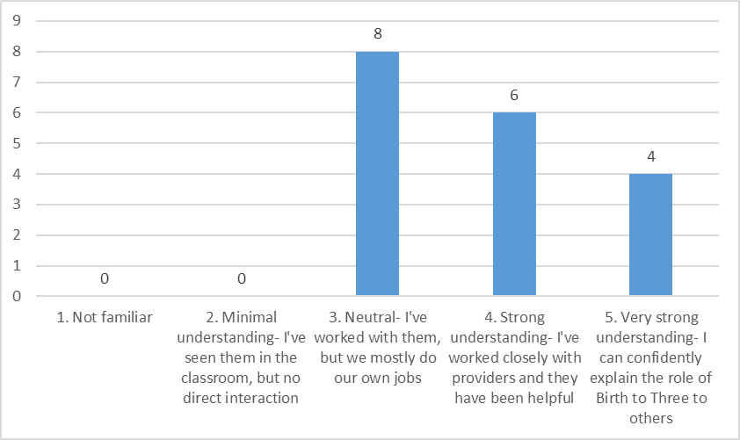
How would you rate your understanding of the role of Birth to Three providers?

Slide 8
Survey Says…
“We usually know when something is just not right about development, but we don’t always know why or how to talk to parents about it”
“We usually talk to our director about it”.
“We try to do the ASQ twice per year, but I think results just go into the child’s file”.
We can conclude with our small sample size that if we improve a teacher’s confidence and understanding, that they will increase their ability to have conversations with parents about their child’s development.

Slide 9
Step 2. Investigate Current Programs
•Connecticut Early Learning and Developmental Standards (CT ELDS)
•Connecticut Documentation and Observation for Teaching System (CT DOTS)
•Sparkler
•Help me Grow
•Ages and Stages Questionnaire (ASQ)
Notes:
Comprehensive developmental milestone assessments
Provide activities and curriculums to work on each domain
Discussion with child care centers- some do quarterly, some do yearly,
Lacking:
What to do if a child is not meeting the milestones. When and how to refer for additional support. How to talk to families about their child’s delays

Slide 10
Step 3. Statewide Protocol Development
Regular monitoring of development using the ASQ
Providing basic education to centers about how the Birth to Three System works and how the two systems can work together.
Facilitating more productive conversations between daycare providers and parents regarding their child’s development using a “Conversation Road Map”.

Slide 11
How will programs generate their own data?
Create access to a uniform system to assist programs in identifying needs
  Work with OEC/B23 to provide child care centers that serve children 0-3 with stipend to purchase ASQ for their center.
  As teachers provide questionnaires to families, they will begin to enrich their own understanding of developmental milestones, increasing confidence.
  Programs can monitor progress and document concerns.

Slide 12
Why the ASQ-3?
Why recreate the wheel?
  Some programs already use this screener
  Help Me Grow utilizes the screener state wide (continuity)
Excellent validity and reliability, developed over 40 years ago.
Parent questionnaire helps bring the parent into the conversation.
Easy developmental questions in all areas of development help to increase the child care provider’s understanding of expectations at a variety of ages.

Slide 13
Confusion Within the System
Knowledge is power! Many daycare centers/providers think of Birth to Three as one program and something they are not a part of.
Create an easy fact sheet for daycare teachers & directors to clear up any questions about the referral process and how the system works.
Having the knowledge about how the system works makes the conversation easier!

Slide 14
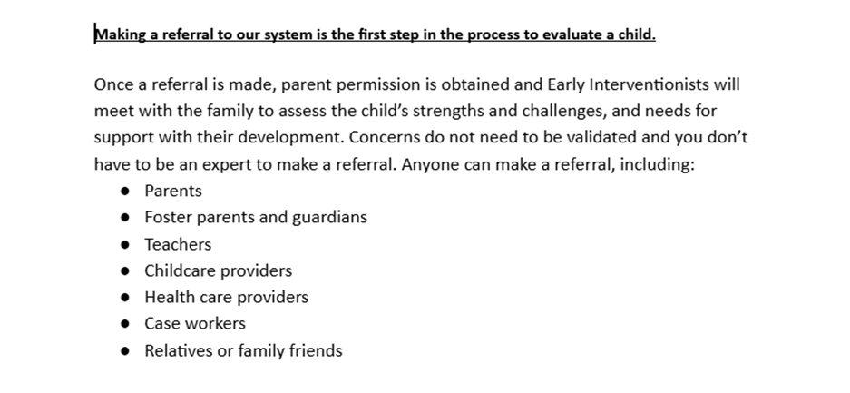
Simple Fact Sheet in Simple Terms- Part 1.

Slide 15
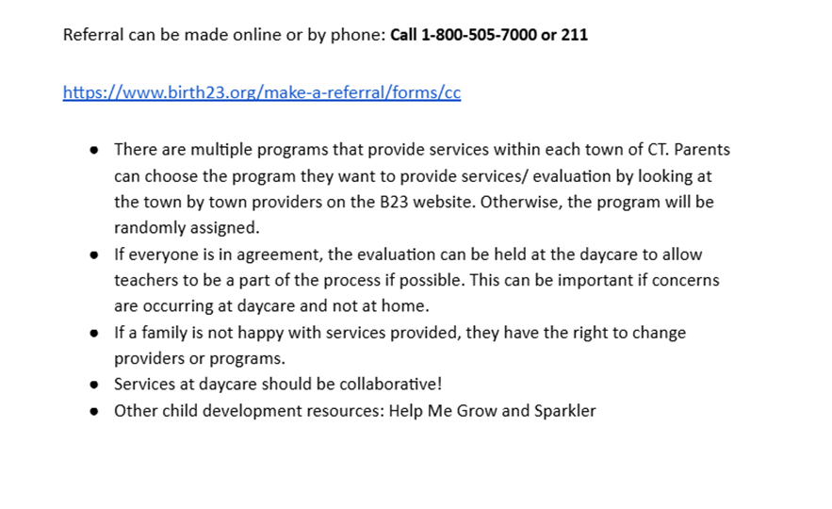
Simple Fact Sheet in Simple Terms- Part 2.

Slide 16
Facilitating Conversations
Daycare providers will be given access and encouraged to utilize the “Development is a Journey Conversation Road Map” developed by Brazelton Touchpoints Center to facilitate conversations with families about their child’s development.
Free access to this tool can be found here.
There are different tools for different types of workers within the early childhood field along with trainings on how to utilize them.

Slide 17
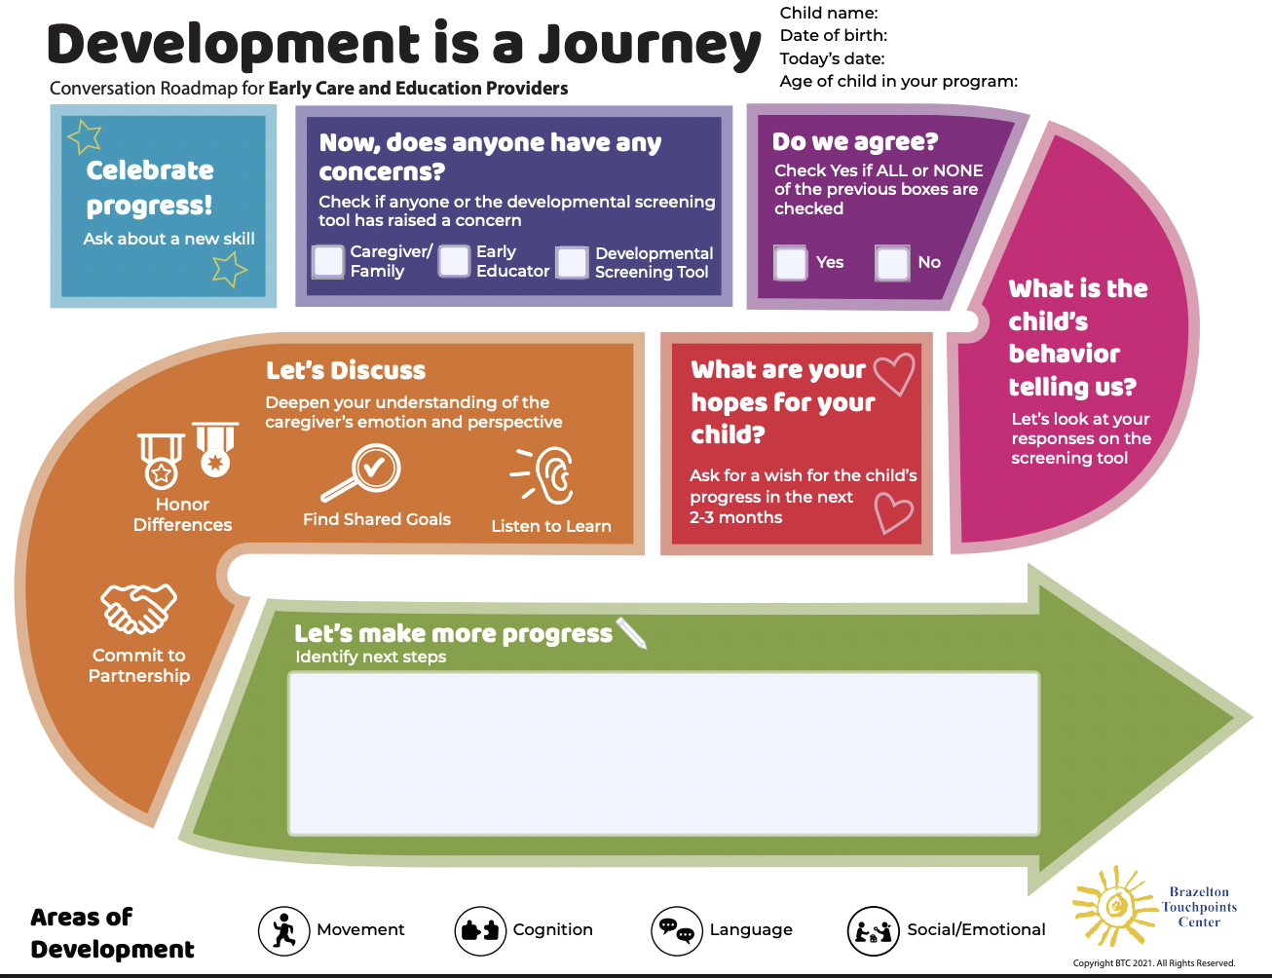
Development is a Journey Conversation Roadmap

Slide 18
Step 4. Determining Success
Informal follow up at 6 months
  Evaluate percentage of referrals made by daycare in the 6 months post implementation of protocol.
  Hold virtual forum for daycare directors to attend and provide feedback/ask questions.
Formal follow up at 12 months
  Evaluate percentage of referrals made by daycare in the 12 months post implementation of protocol
  Re-distribute surveys to daycare centers to re-evaluate the comfort level of staff/directors with making referrals to birth to three

Slide 19
Sources
Bruder, M.B. (1998). A collaborative model to increase the capacity of childcare providers to include young children with disabilities. Journal of Early Intervention, 21(2), 177-186. doi:10.1177/105381519802100209
Daniels AM, Halladay AK, Shih A, Elder LM, & Dawson G (2014). Approaches to enhancing the early detection of autism spectrum disorders: A systematic review of the literature. Journal of American Academy of Child and Adolescent Psychiatry, 53(2), 141–152. [DOI] [PubMed] [Google Scholar]

