Slide 1
Burnout Among Birth to Three Providers and the Importance of
Reflective Supervision and Consultation
Chelsea Galioto, MS SPED &
Lauren Burrows, MA CCC-SLP
June 2, 2025

Slide 2
What is the Problem?
Notes:
Lauren:
Why is RS/C Necessary? Burnout is real
We looked at various surveys about home visitors specifically
University of Illinois Center for Prevention Research and Development 2022 conducted a survey in conjunction with the Department of Human Services, Division of Early Childhood and Bureau of Home Visiting) for the Illinois Maternal, Infant, and Early Childhood Home Visiting (MIECHV)
2022 Results indicated 26% of home visitors expressed experiencing burnout. Compared to (19% in both 2021 and 2020)
Additionally, more than 37% of the home visiting workforce rated their levels of stress as a 7 or higher out of a scale of 1-10 where 10 is the highest.

Slide 3
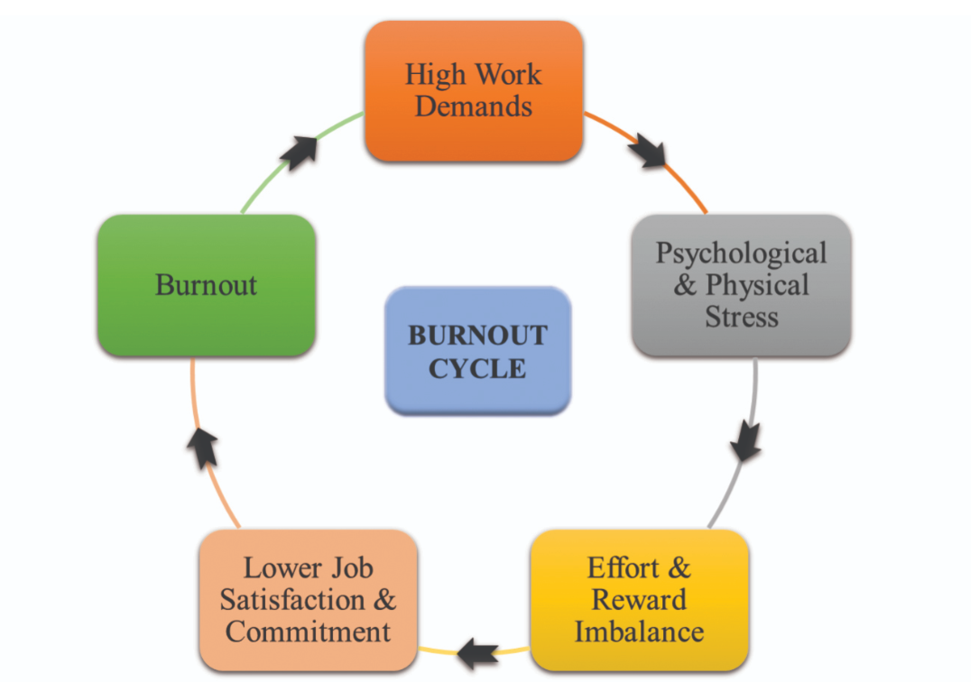
The Burnout Cycle
Notes:
B23 may experience that fall within 3 dimensions:
Emotional Exhaustion
Depersonalization
Decreased Personal Accomplishment
For employees – burnout cycle contains high work demands, stress, effort and reward imbalance, lower job satisfaction / commitment and ultimately burnout.
Families are impacted when a provider is experiencing burnout – provider has decreased ability or is unable to provide high standard developmental support to families and children

Slide 4
What can we do to Address Burnout?
Reflective Supervision and Consultation (RS/C) consists of regular (monthly) meetings with an RS/C trained consultant, either in a group or one-on-one setting.
An opportunity to discuss and reflect on challenging cases, and the emotions they bring up, at work.
“Within the RS/C process, practitioners are able to examine with a trusting consultant the thoughts, feelings, and reactions evoked in the course of working closely with…infants, young children, and their families…through this relationship, strengths are supported, and vulnerabilities are partnered.” (Alliance Best Practices Guidelines)

Slide 5

Why is Reflective Supervision and Consultation Important?
Notes:
Why is RS/C Important?
Knowing that burnout is prevalent for home visitors, as an organization, we must be dedicated to the well being and support of our staff.
RS/C is a proactive approach to SUPPORT the overall well-being and promote the retention of staff
When educators are at their best, work is done well, children receive stronger levels of education / treatment
“Consistent with previous studies of ECE and related helping professionals, we found younger age was associated with increased burnout” (Lee et al. 2013; Moon & Lee, 2005; Simionato & Simpson, 2018)
Younger age significantly associated with emotional exhaustion (possibly due to having fewer work-related coping strategies, increasing vulnerability to symptoms of burnout).
Emphasis and importance of supporting younger professionals through RS/C to promote stability and resilience in the field

Slide 6
How we will Implement Reflective Supervision and Consultation?
Currently, two Regional Supervisors are completing necessary training to become endorsed RS/C consultants.
RS/C consultants maintain endorsement through ongoing participation in their own RS/C group.
Once endorsed, RS/C consultants will facilitate discussion groups with cohorts, monthly.
Each month a member shares. Led by the RS/C consultant, the group engages in reflective discussion.

Slide 7
Who are the Stakeholders?
Internal Stakeholders:
Rehabilitation Associates, Inc. Birth to Three Providers
RS/C Consultants
Rehabilitation Associates, Inc. Birth to Three Administration team
External Stakeholders:
Connecticut Association for Infant Mental Health (CT-AIMH)
Office of Early Childhood
Other Birth to Three programs in Connecticut

Slide 8


Determining Efficacy
Notes:
How will we measure impact?
During the pilot phase, we will allow for self-selected groups
Take Pre and Post RS/C Survey
Questions on the survey will be, at a minimum, tailored to determining current levels of burnout, feeling supported over all mental well being and the impact of RS/C

Slide 9
Ongoing Implementation in Birth to Three
Analyze pre/post data after a year of implementation.
Adjust group size and frequency of meetings, as needed.
Potentially add a ‘new clinicians’ group, as they are a particularly vulnerable population. (Zero-to-Three)
Depending on the needs of the agency, we may need additional endorsed RS/C Consultants.
For systematic change, our pilot program and data will be shared with other Connecticut Birth to Three Providers.

Slide 10

Thoughts and Questions?

Slide 11
Resources
Connecticut Association of Infant Mental Health (CT-AIMH) https://www.ct-aimh.org/
University of Illinois Center for Prevention Research and Development (CPRD) – 2022 MEICHV Survey
Reflective Interaction Observation Scale Guide (RIOS) by Christoper Watson
A Practical Guide to Reflective Supervision, Edited by, Sherryl Scott Heller and Linda Gilkerson

Slide 12
Resources Continued
The Relationship Between Reflective Supervision/Consultation and Reduced Burnout Among Early Education Professionals, by Thomas W. Pavkov and Lee Wells (2023 Zero to Three Journal)
Infants and Young Children: Professional Development Through Reflective Consultation in Early Intervention, by Christopher Watson and Shelly Neilsen Gatti (2012 Infants & Young Children Journal)
Decreasing Burnout and Promoting Well-Being among Early Childhood Educators, by P. Avari, A. Napoli and H. Hatton-Bowers (2021 Nebraska Extension's NebGuide)

Slide 13


Follow UConn UCEDD
Don’t forget to follow us on social media!
Facebook
Instagram

