Slide 1
Birth to Three and Early Childhood Child Care Center Professional Development and Collaboration
Elaine Balsley, Gail Passley, Michele Stevenson

Slide 2
Rationale
It can be said that Early Childhood providers are facing high staff turnover, coupled with challenging behaviors in their classrooms and are in need of support. There are many classrooms in which Birth to Three providers are providing services for children with special needs (some identified, and some not identified).This impacts the Child Care provider’s ability to manage the classroom while striving to provide a quality program for all children, even more so if staff is less experienced/trained.
It would be ideal for Early childhood Care centers to be able to receive support from highly qualified Birth toThree interventionists in order to assist them by providing strategies to manage
their classrooms, provide necessary support to all children, and also to better understand the role of Early Intervention. Moreover, Early Childhood providers would also gain a better understanding of child development particularly in terms of their expectations for each child.

Slide 3
Action Plan
Identify three Early Childhood Child Care Centers that are interested in participating in a pilot program; 1 from each geographical area represented by the project leaders
Develop proposal to be shared with the childcare center administrators
Create a survey that seeks to identify what types of supports/strategies would be most helpful to the individual childcare centers
Use the information gathered from the surveys to create a professional development plan and schedule presentations with each center.
Complete the professional development plan.
Collect an exit survey to determine if the childcare centers found it helpful
Seek funding through available PD Grants

Slide 4
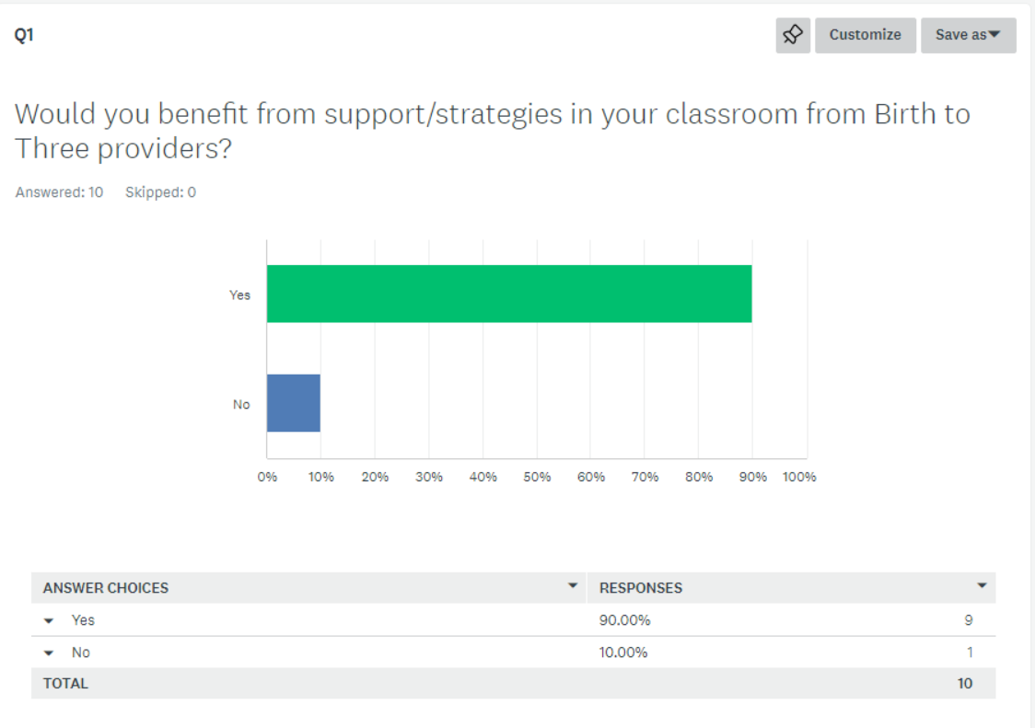
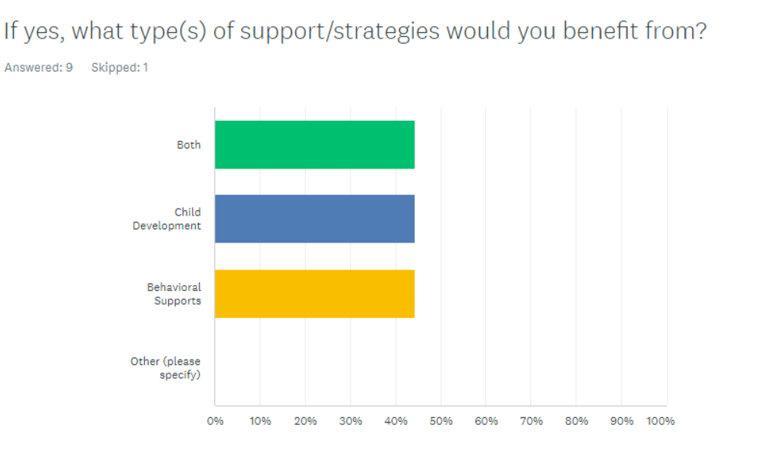
Survey Results
Question 1- 90% responded yes
Question 2 – 44.44%

Slide 5
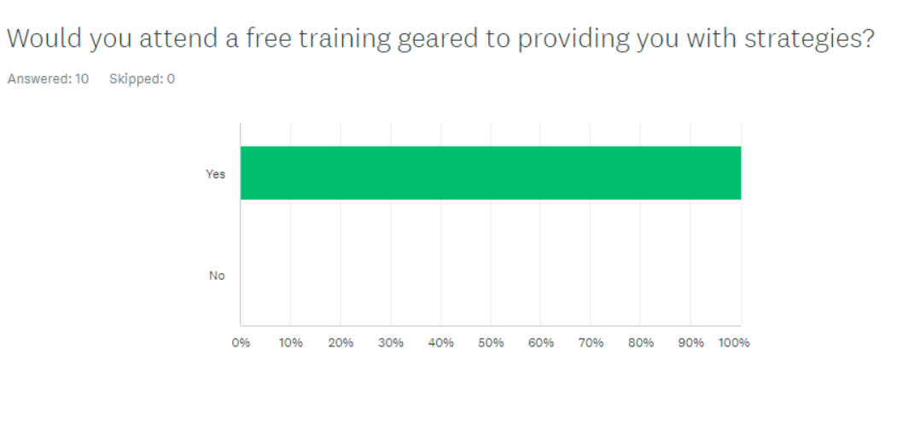
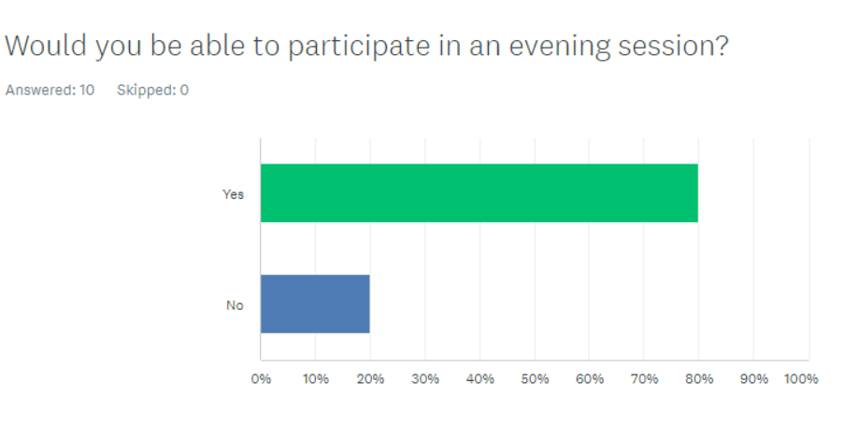
Survey Results Cont’d
Question 3- 100% yes
Question 4- 80% yes, 20% no

Slide 6
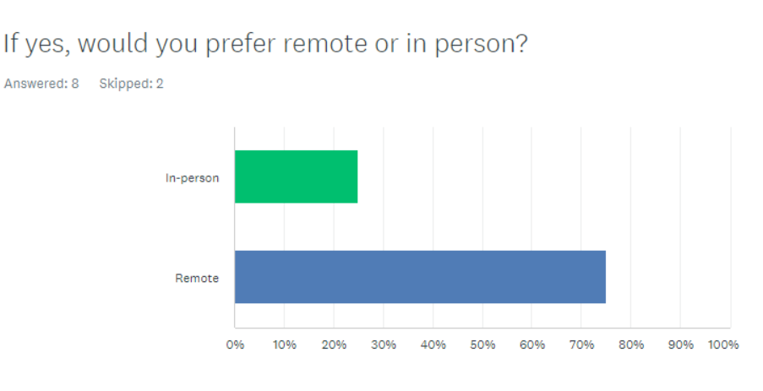
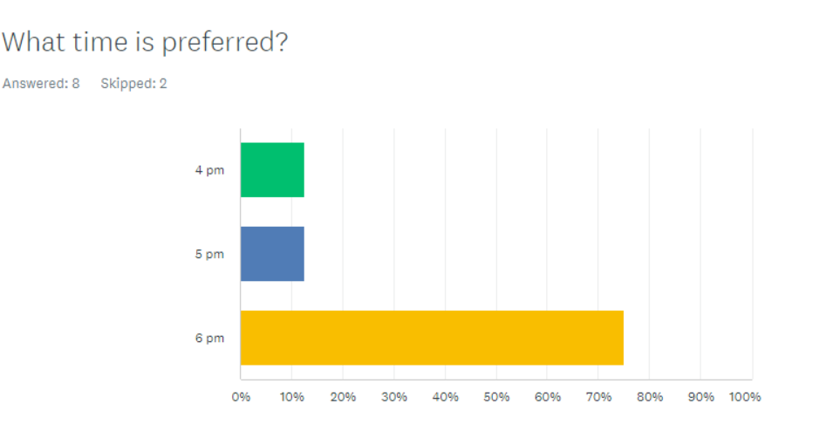
Survey Results Cont’d
Question 5
Question 6- 75% preferred 6pm

Slide 7
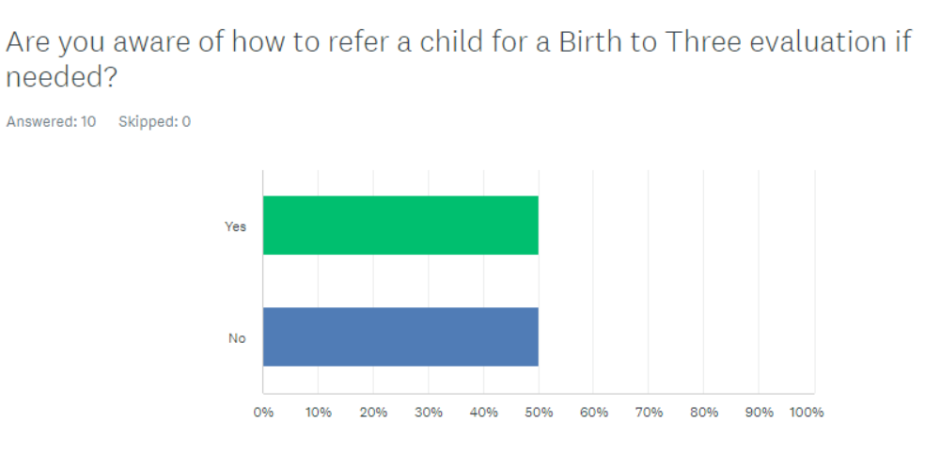
Survey Results Cont’d
Question 7

Slide 8
Next Steps
Develop and customize the presentation to target concerns that were identified in the survey
Collaborate and schedule the Professional Development presentation with the Director of the Child Care Center
Provide exit survey after completion of training and analyze data
Present data to the Lead Agency for review and determine next steps

Slide 9
Focus of Presentations
Speech and Language Development in Early Childhood
Role of Communication in Addressing Challenging Behaviors
Addressing Challenging Behaviors and Increasing Social Connections Across the Classroom Routine
Supporting Toddler's Development of Self-Regulation
Approach with Curiosity: Reframing Challenging Behaviors
Understanding the Birth to Three Process

