Slide 1
Establishing Family Connections in Connecticut Birth-to-Three
Erin Costa, M.S., BCBA, LBA

Slide 2
“Research shows that families often receive their greatest source of support from other parents whose children have similar disabilities but who are older.”

Slide 3
What is the current procedure?

Slide 4
Service Coordination Procedure/Responsibility to Establishing Family Connections as related to Connecticut Individualized Family Service Plan
  Family Map (ECO Map)
    An ECO-map allows the service coordinator and family an opportunity to identify the important people and supports a family uses during the week & the dynamic of these relationships and what supports/resources by be beneficial for the family or the important people that are identified
  Would you like to talk to a family that has been through a similar situation or whose child has gone through Birth to Three?

Slide 5
“It is important to ask families if they would like to be contacted by another parent whose child has gone through Birth to Three rather than simply giving them a brochure on a parent organization or telephone number to call. Often family members are too overwhelmed to initiate a call or they lose the number or brochure under the avalanche of initial paperwork. If a parent is interested in being contacted by another parent or an organization, have them sign a CT Birth to Three release of information (Form 3-3) or one provided by the parent organization. You can then notify the parent or the organization of the contact information of the interested family. If the parent is initially not interested in being contacted, there is a space to indicate when the parent may be interested in being asked again. The service coordinator should continue to ask this question not just at each IFSP meeting, but also throughout the family’s time in the Birth to Three System.”

Slide 6
Objectives:
Gather information on if the current procedure is effectively supporting families
Determine how Service Coordinators are discriminating the resources to the families they serve
Is CPAC finding families want to make connections through the mentor program or are other resources frequently accessed with similar effect.

Slide 7
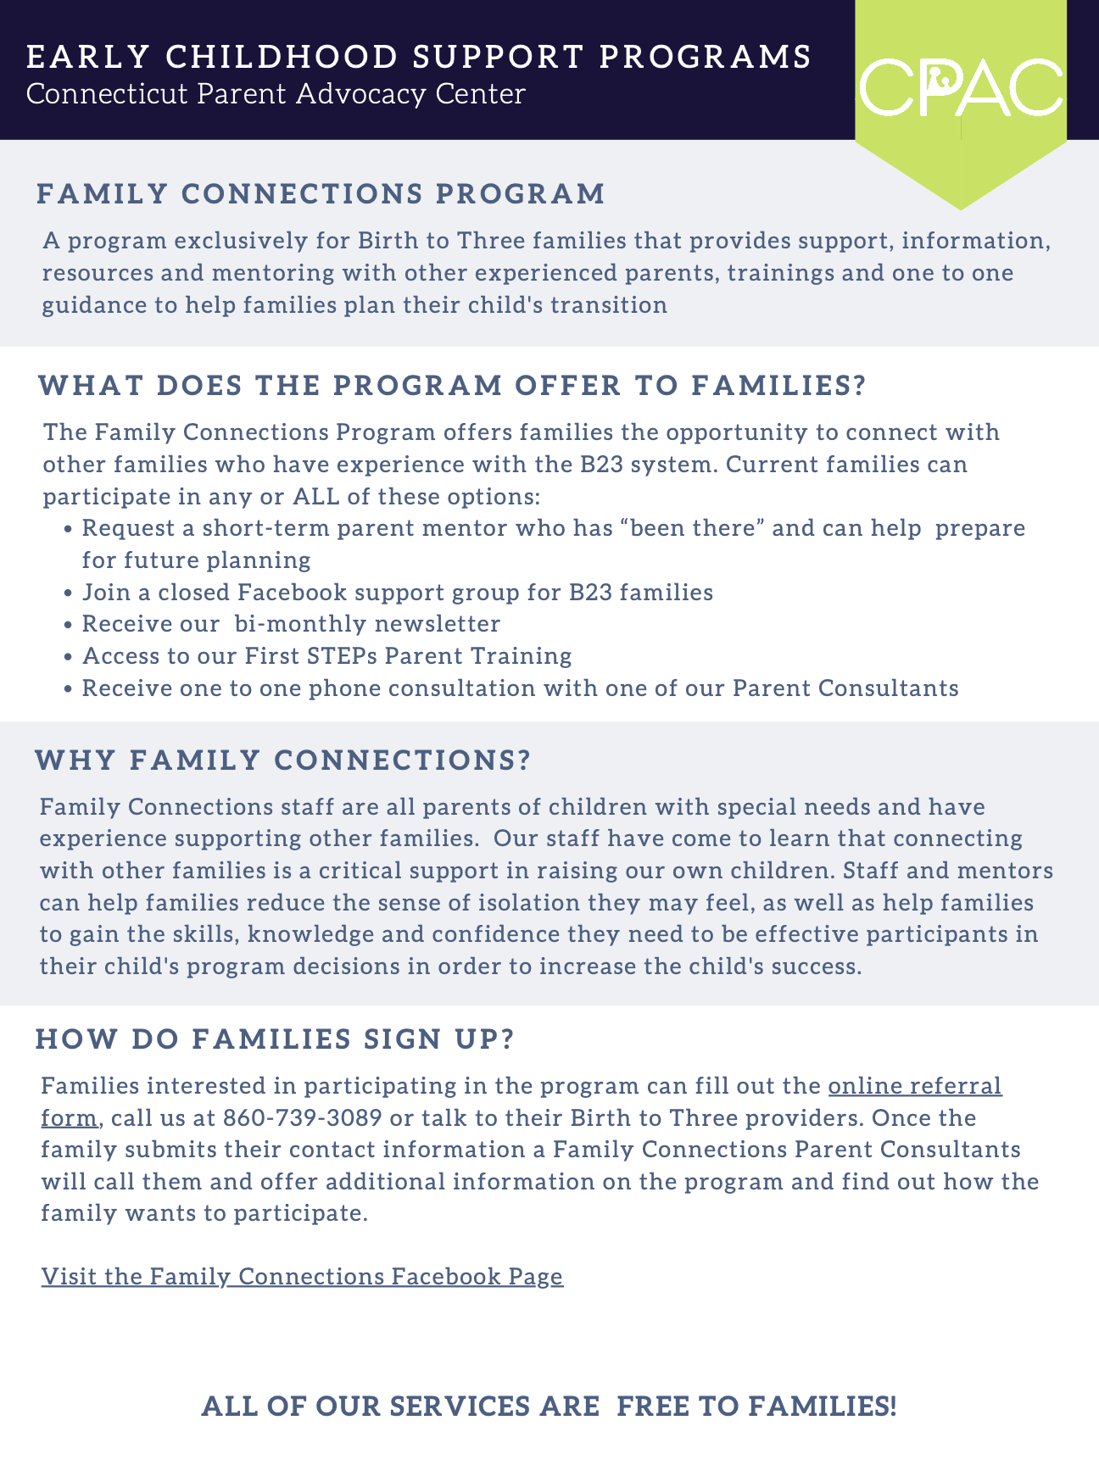
Completed Task
Communication with CPAC
  Adriana Fontaine
    Beyond Family Connections IFSP Statement

Slide 8
Next Steps
Survey to Service Coordinators (knowledge of resources, disseminating resources)
CPAC Data Collection via Reporting (participation numbers)
Does the IFSP need to change or how can we better track the resources?

Slide 9
References
(2022, July 29). Procedures. Connecticut Birth to Three. Retrieved March 13, 2023, from https://www.birth23.org/providers/provider-resources/procedures-2/
Family Connections. Connecticut Parent Advocacy Center Connecticut's Resource for Children With Disabilities; Empowering and Educating Families. Retrieved March 13, 2023, from https://cpacinc.org/programs-family-connections.aspx

