Slide 1
Identifying & Supporting Sleep Concerns for Children in Birth-Three
Liberty Mahon
B-3 Developmental Therapist
Child Sleep Consultant

Slide 2
SLEEP & DEVELOPMENT
The brain is the only organ in the body that requires sleep to function properly.
-Dr. Marc Weissbluth
Sleep affects:
  Mood
  Behavior
  Physical Health
  Mental health
  Cognition
  Attention and Memory
  Motor Development
  Language Recall and Acquisition
Sleep problems affect all domains reported on the Child Outcomes (positive social-emotional relationship, acquiring and using knowledge and skills, taking action to get needs met).

Slide 3
SLEEP CONCERNS & EARLY CHILDHOOD
Behavioral sleep problems in young children:
affect between 20-40% of children ages 1-5 years
affect 40-75% of children with developmental delays
occur across cultures
one of the most common issues brought to the attention of pediatricians

Slide 4
IDENTIFYING SLEEP CONCERNS IN EARLY INTERVENTION
About half of the instruments used to assess and evaluate children in early intervention had items related behavioral sleep (mean 1.5 items)
No instruments of have any items related to respiratory sleep concerns
General sleep questions are often collected for background information rather than for screening purposes and were determined inadequate to determine whether a child requires a referral for a sleep disorder
Although validated pediatric sleep scales are available, they are rarely used in early intervention.
Lack of sleep screening tool use = Under recognition & diagnosis of sleep disorders
Bonuck,K.,A., Hyden, C., Ury,G..et al (2011). Screening for sleep problems in early intervention and early childhood special education.Infants & Young Children.24(4),295-308.

Slide 5
WHAT HELPS FAMILIES IMPROVE THEIR
CHILD’S SLEEP?
PARENT EDUCATION & MEDICAL INTERVENTION
Specific Parent Education has been found to beneficial in improving multiple aspects of infant and toddler sleep, especially sleep onset, night waking, sleep consolidation, as well as maternal sleep and mood
Referral to ENT, pulmonologist, or other sleep specialist can resolve respiratory sleep concerns
Referral to neurologist or other sleep specialist can assist with sleep concerns related to other medical conditions
IN ORDER TO IMPROVE SLEEP, WE MUST BE ABLE TO IDENTIFY CONCERNS AND HAVE ACCURATE INFORMATION TO SHARE

Slide 6
STEPS COMPLETED:
Literature review
Review of pediatric sleep scales
Shared idea with OEC and begun to collaborate
Conducted a Sleep Survey to all B-3 providers & directors
Conducted a Sleep Education Survey with B-3 Providers that have received sleep education from a sleep consultant
Conducted a Sleep Education Survey for Families that have received sleep education from a sleep consultant
Drafted Sleep Screening Tool
Contacted other sleep consultants

Slide 7
WHAT I HAVE LEARNED ABOUT ABOUT B-3 PROVIDERS & SLEEP CONCERNS
95% ask families about their child’s sleep habits
92% do not use a sleep scale to identify sleep concerns
66% report cancellations due to sleep reasons sometimes or often
96% report that families report sleep concerns sometime or often
68% do not have a team member with sleep expertise
54% feel neutral about their ability to support families with sleep concerns
93% would like more training related to sleep
97% would like written information to share with families
n=122

Slide 8
WHAT PROVIDERS & FAMILIES THINK ABOUT
SLEEP EDUCATION
The B-3 providers surveyed (n=12) 100% found all of the information provided to them by a sleep consultant helpful. This information included topics such as the sleep needs of infants and toddlers, sleep environment, sleep routines, sleep schedules, ways to treat sleep associations, and the science of sleep. The majority felt (91%) felt that they were better able to support families with sleep concerns after receiving education related to sleep.
The majority of families that have worked with a sleep consultant found the above information helpful. Most of the families survey (n = 19) felt that they could continue to support their child’s sleep habits from the information gained (95%) and 85% reported that their child’s sleep improved after working with a consultant.

Slide 9
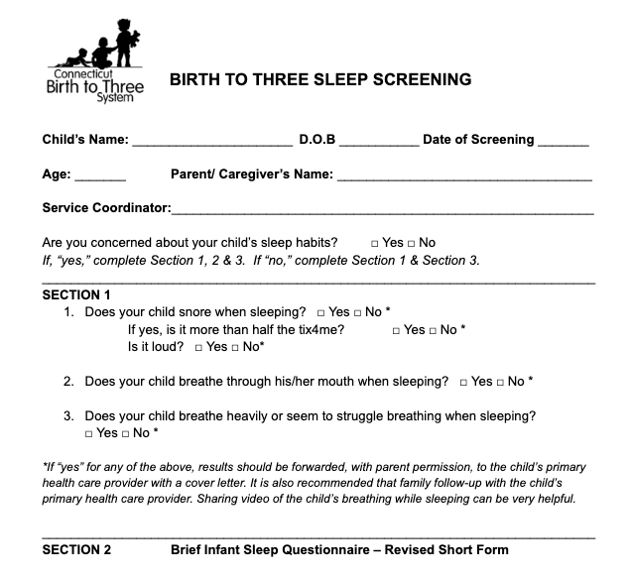
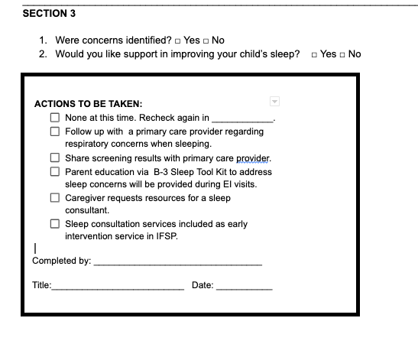
DRAFT OF SLEEP SCREENING TOOL

Slide 10
NEXT STEPS
Continue to work with OEC to determine how this project can be supported
Finalize the Sleep Screening Tool
Develop a Sleep Tool Kit that providers can share and discuss with families
Educate all B-3 agencies virtually about these new tools and how to use them.
Determine if Peer to Peer TA would be effective in continued support for providers.
Post-provider education survey to determine effectiveness of Sleep Screening Tool and Sleep Tool Kit.

