Slide 1
Increasing Self-Referrals in Early Intervention
June 2, 2025
Reagan Wentzell
Emily Schernau

Slide 2
Problem Identification
Continued belief amongst parents that only pediatricians/medical practitioners can make a referral to Birth to Three
Lack of information in pediatric medical offices about how Birth to Three works
Lack of information amongst community partners (DCF, Early Head Start, WIC, daycare providers, library programs) about who can make a referral and how to do so

Slide 3
Consequences of the Problem
Children with inconsistent medical providers (no selected PCP) often have a delay in Birth to Three referrals
A delay in the referral process results in less length of time of service, and possible delays in transition to school IEP services

Slide 4
The Proposed Solution
Increasing materials distributed to community locations such as:
  Libraries
  Doctor’s offices
  Community Centers
  Parks/Playgrounds
  DCF offices

Slide 5
Content of Materials
Key Features:
  Printed in large font in basic language (no greater than 6th grade reading level)
  Printed in different languages on the same flier
  QR code for easier access to the website to refer
  Flier specific for clinicians with more technical information
Key Messages:
  How to make a referral
  Major milestones to be looking for at certain ages
  Where to go for more information

Slide 6
How Distribution Would Work
Medium sized print materials with QR codes for community locations
Flyer sized print materials (half page size) to be given to each parent at end of doctor appointment
Educational fliers for clinicians/community partners about how Birth to Three works and the benefits of aiding families in referral

Slide 7
Community Partner Support
What do community partners perceive are the barriers to referring children to Birth to Three
  “Wait and see” approach
Peer to Peer education about:
  The impact early referrals have on overall development
  What signs may warrant a referral

Slide 8

Sample Flyer

Slide 9
Measuring Progress
Before/After data: percentage of family referrals over a 6-month period
Before/After data: percentage of average age of referral for non-auto eligible children
Follow up survey from stakeholders/community partners regarding their comfort recommending referrals and answering parent questions about Birth to Three

Slide 10
Barriers to Implementation
Buy in from stakeholders
Capacity of agencies to do community outreach
Funds for printed materials and the staff to distribute

Slide 11
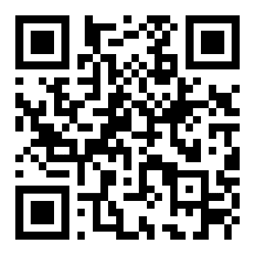
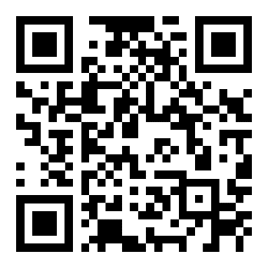
Optional
Don’t forget to follow us on social media!
Facebook
Instagram

