Slide 1
Mentorship in Early Intervention
A Blueprint for Program Development
Kaila-Ruth Keefe, MOTR/L

Slide 2
Presentation Agenda
Identification of Need
Rationale for Mentorship
  Data on Provider Retention Rates
  Salary Information for Early Intervention Professionals

Slide 3
Presentation Agenda
Proposal
  Design of 12 week program
  Competency Based
  Mentor Relationship
    Coaching Connection
    Primary Service Provider Model
Implementation Timeline
  Data Driven Outcomes

Slide 4
Literature Review: Why Mentorship?
Across multiple studies, mentorship relationships in early childhood education resulted in improved provider retention, quality of services provided and continuity of services.
In Early Intervention (EI) it is hypothesized that the quality improvements noted in the studies would lead to stronger provider-family relationships.

Slide 5
Identification of Needs: Why Mentorship?
When provided with an informal survey Birth to Three providers with less than 1 year in the field (n=6) 100% of respondents indicated that formal mentorship would be valuable.
Retention and Recruitment of Providers
Parent Perceptions of Birth to Three (B23) Programs
Notes:
I feel that a prototype of a mentorship program in early intervention could bolster the hiring process for early intervention programs statewide which would work toward closing the gap between family needs and current birth to three staffing issues. I also feel that it would promote high quality services which would challenge the perception from recent parent surveys that the quality of programs in the CT Birth to Three program has decreased over the past 3 years. Additionally, the survey results noted that parents are aware of staffing shortages which also impacts their perception of the quality and comprehensiveness of their child’s services. By creating a mentorship program I feel that we would be able to attract and retain staff which would work to alleviate that hardship and bolster parent perceptions of the program.

Slide 6
Why Mentorship: Provider Perceptions
Informal Anonymous Survey:
Areas of need that were identified included:
scheduling and general organization (83%)
service coordination (100%)
  meeting timelines (100%)
building relationships with families (66%)
improving coaching skills (83%)
Notes:
All respondents felt that a formal mentor relationship would promote increased feelings of competence and decreased feelings of overwhelm within the first year of practice in B23

Slide 7
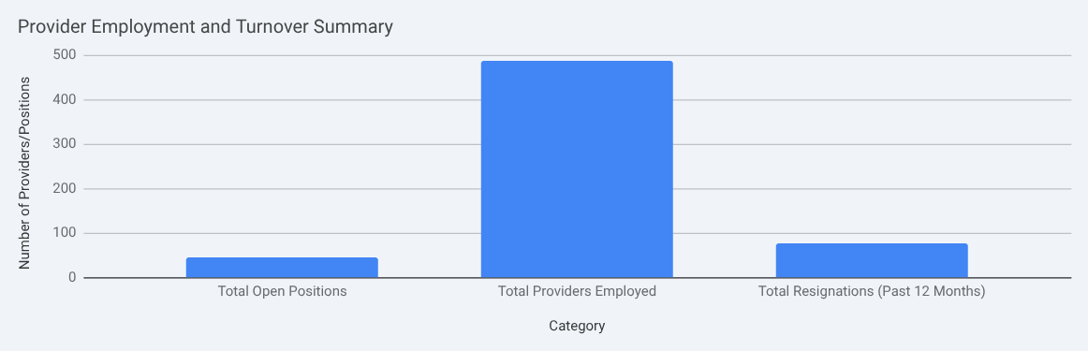
Current Data in Support of Mentorship
Provider Retention Rates
  RAIN: Stay Tuned
  Directors Survey: Recent Data
Notes:
Comprehensive Data related to retention and recruitment is not yet available in the State of CT. Koleen Kerski (Education Project Coordinator for the OEC) informs us that the RAIN data system is currently under development and will contain a managed staff screen that will have that capability when it is deployed.
In efforts to communicate data regarding hiring and retention a survey was conducted amongst leaders in Birth to Three programs across the state. Results are limited at this time but show the following

Slide 8
Key Takeaways from Retention Data
High Provider Turnover and Vacancies
The data indicates a significant level of provider turnover, with a total of 76 resignations reported in the past 12 months across the respondents. This is coupled with 45 current open provider positions, suggesting ongoing recruitment challenges.

Slide 9
Key Takeaways from Retention Data
Compensation is a Major Factor
Low pay and a lack of competitive benefits are frequently cited as reasons for both resignations and declined job offers. Many providers are leaving for positions in schools or clinics that offer better compensation and work conditions.

Slide 10
Key Takeaways from Retention Data
Specific Disciplines are Hard to Fill
There's a notable difficulty in recruiting for disciplines such as Speech Pathologists, Occupational Therapists, Physical Therapists, and Social Workers.

Slide 11
Data: Parent Perceptions
2023 STATE PERFORMANCE PLAN / ANNUAL PERFORMANCE REPORT
PART C identified that: Percent of families participating in Part C who report that early intervention services have helped the family help their children develop and learn decreased from 98.6% to 94.68.
Notes:
During FFY23, fewer families reported that participating in Part C helped their family help their children develop and learn (4c of this indicator). While evaluating the raw data and family comments, the state attributes the slippage and not meeting the state target to the workforce shortage. Some parents voiced that they observed the workforce shortage.

Slide 12
Proposal: 12 Week of Mentorship
Competency Based
  Designed across the tenets of early intervention.
    Family-centered practices, natural learning environments, and coaching as a style of intervention
  Personal organization and planning/ scheduling: paperwork
  Service Coordination
  Planning Joint Visits
  Preventing professional burnout and compassion fatigue

Slide 13
Design: Mentor/ Mentee Pairings
Mentorship pairings will be coordinated by regional teams and co-visit pairings (disciplines who co-treat frequently).
Leads will be assigned to each discipline (OT, PT, SLP, DT) and each lead will assume a mentor role for their discipline.
Efforts will be made to have continuity between mentor/ mentee teams and mentor coaches/ mentees.

Slide 14
Incentive and Support
New Graduate Recruitment
  example in the field: Fox Rehab
Strengthen Clinical Fieldwork Program
  increased interest in Early Intervention
Support
  Weekly drop in office hours
  Whole team staff meeting
    mentor specific structure
  Financial incentives for mentors
Notes:
It is my hope that offering a mentor program will, in and of itself provide incentive for new graduates to consider a position in early intervention. I feel the mentor program will strengthen our clinical fieldwork program which in turn will create more interest in the field of early intervention prior to graduation from graduate programs.
Some supports include: drop in office hours offered on a weekly basis, whole team staff meeting weekly with mentor specific structure for sharing problems and gaining supports from the whole team. Financial incentives for meeting important service coordination and state regulations across each quarter. Potential to earn paid time off for timely completion of services per the IFSP.

Slide 15
Implementation Timeline
What will the timeline for implementation look like beyond the 12-week mentorship?
Continue weekly drop in office hour for support
Monthly formal check ins between mentor/ mentee
Yearly self assessment for mentee to identify strengths and needs
Whole agency professional satisfaction survey to be completed by each staff member annually
Continuing professional development

Slide 16
Data Driven Outcomes and Quality Indicators
How will you evaluate participant progress throughout the 12 weeks?
Mentee pre/ post test for 6 competency areas
Structured observations during visits
  observational checklist
Parent/ Family feedback via survey
State Level Data Collection

Slide 17
References
Hobb, M. K., & Stovall, R. (2015). Supporting mentors of preservice early childhood education teachers: A literature review. Journal of Early Child- hood Teacher Education, 36, 90-99.
Chu, M. (2010). Observe, reflect, and apply: Ways to successfully mentor early childhood educators. Dimensions of Early Childhood Education, 40(3), 20-28.

Slide 18
References
Agbenyega, J. (2012). How we view our theoretical competency: Early child- hood pre-service teachers’ self-evaluation of a professional placement experience. Australasian Journal of Early Childhood, 37(2), 141-147.
Cheng, M. and R.S. Brown (1992). A Two-year Evaluation of the Peer Support Pilot Project: 1990-1992. Toronto, Ontario, Canada: Toronto Board of Education, Research Department.

