Slide 1
Play-Based Curriculum Aligned with Connecticut Early Learning and Development Standards and Documentation (ELDS) and Observation for Teaching System (DOTS) to Improve Student Outcomes
Prudenza Lederman
Speech Language Pathologist, Winchester, CT plederman@winchesterschools.org
Carol Guerrette
District Supervisor of Special Education, New London, CT carolg2@sbcglobal.net
June 2, 2025

Slide 2
What are CT ELDS and DOTS
Definition: CT ELDS include what young children 0 to 5 years old should know and be able to do. These standards were developed so that families, communities, and schools can work together to support children's early learning and growth in all settings. DOTS is a framework to guide educators in the a process of monitoring student's progress, skills, abilities, and behaviors through observation.
Goals: Early education teachers to align the curriculum with the CT ELDS and utilize DOTS to guide their teaching, improve student outcomes and increase parent engagement.
Outcome: To increase measure and assess a student's development, ensure teacher effectiveness, implement a developmentally appropriate play-based curriculum, and include family partnerships.

Slide 3
Inconsistent Use of CTELDS and DOTS
Connecticut early childhood educators are currently not aligning the CT ELDS to the their curriculums and obtaining observational data utilizing the DOTS.
  Early learning environments not utilizing CT ELDS to target learning experiences and student outcomes based on the student's growth and development may not be targeting appropriate skills in the early years.
  Age-appropriate content and specific student learning objectives are not always understood by many stakeholders.
  Families may lack an understanding of how their child learns and how to support them during the PreK years.

Slide 4
Implementation of CT ELDS and DOTS
It is critical to create play-based activities aligned to the curriculum using CT ELDS. The ELDS target student developmentally appropriate goals, and support the collection of observational data that inform teachers, parents and stakeholders.
Currently within preschool classrooms, play-based activities do not always meet the student at their developmental level and observational data is not consistently taken to support student learning and report what is needed next.

Slide 5
What the State of Connecticut says
The State of Connecticut (CT) uses its Early Learning and Development Standards (CT ELDS) to guide and support early childhood education. It provides guidance to educators to support them within the curriculum and instruction to plan center-based activities that are suitable for the student's age and developmental stage. CT ELDS can be used to plan additional supports for students with diverse needs ensuring access, and participation through consistent monitoring and assessment for growth.

Slide 6
What the State of Connecticut says
CT ELDS provides the educator with opportunities to support diverse learners, communicate, collaborate with families and stakeholders utilizing a shared vocabulary to discuss student's development and learning.
CT ELDS supports with student planning, transitions and aligns with the Common Core Standards.

Slide 7
Benefits
DOTS is utilized with CT ELDS to monitor student progress by collecting observational data on student progress, skills, and behaviors.
  Informed planning of student needs
  Makes curriculum adjustments and teaching practices
  Provides opportunity for quality improvements and builds capacity for teachers to complete additional professional development
  Provides resources to families to support their student's development

Slide 8
Key Aspects of CT ELDS and DOTS
Early childhood general education and special education teachers collaborate using the same framework
  CT ELDS recognizes MLL learners develop language differently and adjusts the framework using language acquisition stages
  CT ELDS is inclusive. It can be used to inform and guide goals and objectives for students with Individual Education Plans (IEP), 504 plans, and SRBI/MTSS
DOTS is used for gathering data on young children's skills, abilities and behaviors. Summarizes information on student performance, next steps, and supports capacity for teachers to enhance additional student learning through specific activities

Slide 9
Key Aspects of CT ELDS and DOTS
DOTS supports early childhood educators and is utilized with CT ELDS to monitor student progress by collecting observational data on student progress, skills, and behaviors.
  Monitor and support planning for student needs
  Make curriculum adjustments and teaching practices
  Provide opportunity for teacher improvement and build understanding for teachers
  Inform additional professional development needed to engage students for educators
  Provides resources to families and plan engaging experiences to support student development and specific learning

Slide 10
Pilot Phase
Short Term Objective #1: Specific resources and trainings for learning will be used during professional development to train teachers to implement CT ELDS and DOTS.
  Survey to teachers to obtain an initial comfort level inventory
  Collaboration with curriculum coach
  Webinars
  Examples of application to the curriculum
  DOTS implementation within the classroom
  Feedback walkthroughs/self reflection

Slide 11
Pilot Phase
Short Term Objective #2: Collaboration with staff on aligning the curriculum and lessons utilizing CT ELDS.
  Mapping out play-based activities using play-based learning indicators
  Modeling centers/engaging activities
  Mentoring/modeling from coaches/colleagues
  Curriculum guidelines/expectations
  Implementation of curriculum to meet student where they are

Slide 12
Plan
Short Term Objective #3: Monitor effectiveness of CT ELDS integration by using a rubric to assess classroom alignment, observation with the use of DOTS, and providing feedback on classroom implementation of individual plans.
Data Team collaboration-weekly
Ed Advance Coach: classroom observation
Creating checklists or templates for data collection
Reviewing data collection: revisions

Slide 13
Data Collection
Short Term Objective #4: Data collection obtained from DOTS allows the staff to address potential challenges and developing a plan to remediate.
  Level of adult involvement/engagement (e.g. teacher, paraprofessional)
  Extent to which the child is directed in learning
  Provides information on where the students are currently presenting and where they need to go
  Specific learning activities that enhance learning

Slide 14
Parent Involvement
Short Term Objective #5: Parent involvement is key. Sharing information with families on their child’s develop supports understanding
Educate parents about the curriculum and assessment tools, and particularly how it supports individual learning.
Parent friendly handouts- CT ELDS, DOTS
Once a month workshops led by teachers
Every month target a section of the CT ELDS with stations that can replicated at home. Send home information.
Highlight different components of the CT ELDS to address areas of need to communicate common goals

Slide 15
Professional Development
Short Term Objective #6: Professional development documentation: keeping track of learning and reflections throughout the process, which can be valuable for future reference and mentoring others as students transition into elementary schools and Kindergarten
Creating digital tool kit and team folder allows staff to share learning plans and review student outcomes
Data supports the student as they transition from PreK to Kindergarten and Teachers can begin utilizing CT ELDS K- crosswalk to support the process

Slide 16
Data Analysis
Data obtained from the beginning of the year and middle of the year. End of the year data is currently being complied.
Data supports growth and development in aligning with the state standards
DOTS supports intentional teaching and planning play-based experiences that supports student's development, gathering information on how students are progressing and adjusting within the curriculum.

Slide 17
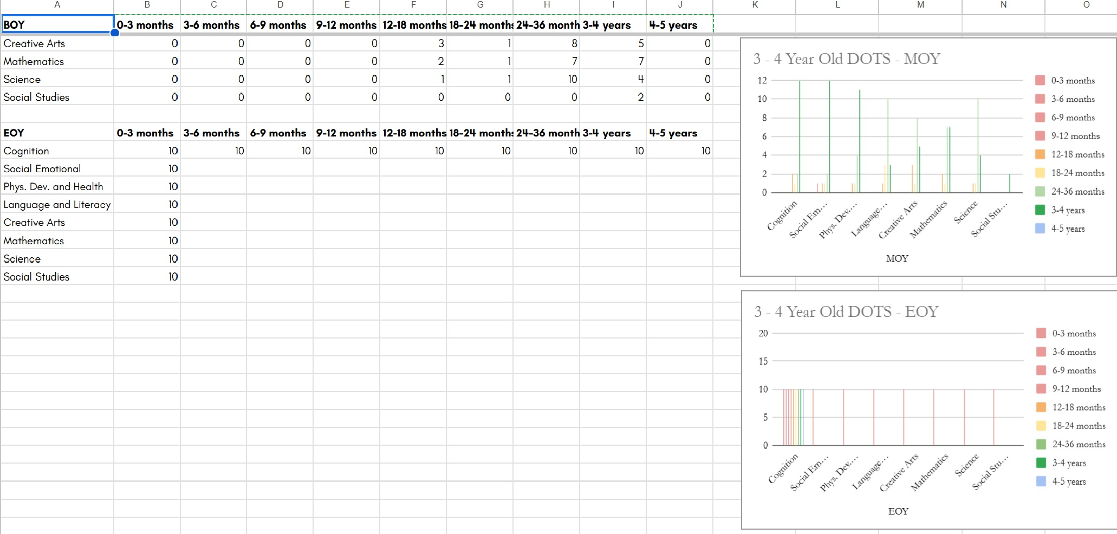
CT ELDS DATA: 3-4 year olds

Slide 18
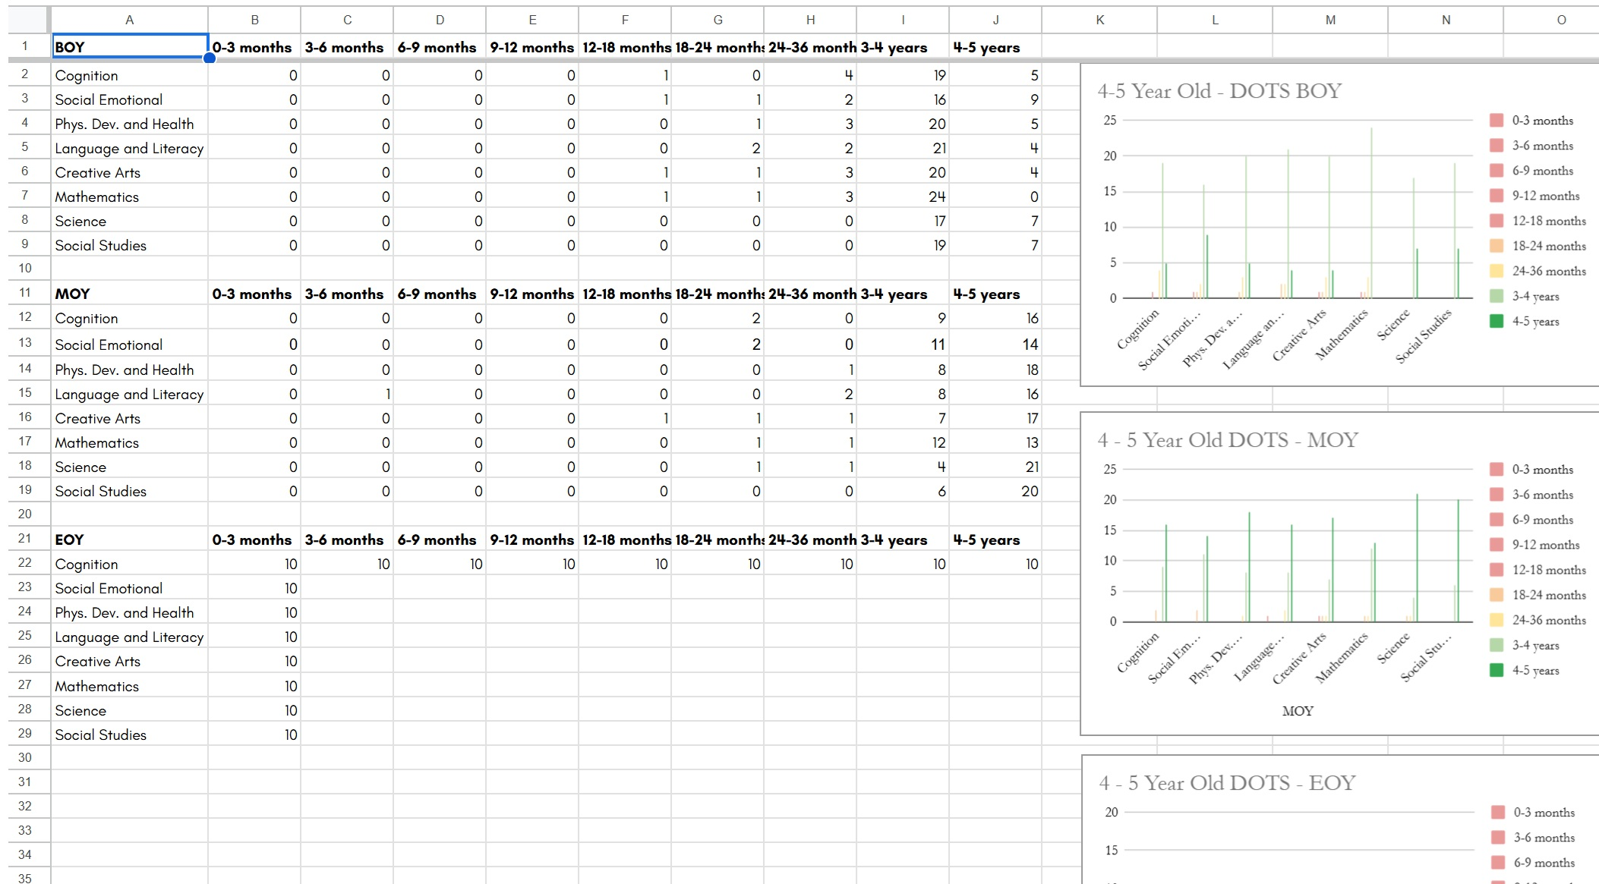
CT ELDS DATA: 4 to 5 year olds

Slide 19
Resources
Connecticut Early Learning and Development Standards (CT ELDS)
https://www.ctoec.org/forms-documents/ct-elds-what-children-birth-to-five-should-know-and-be-able-to-do.pdf
Connecticut Documentation and Observation for Teaching System
https://www.ctoec.org/supporting-child-development/ct-dots/
The Preschool Inclusion Toolkit (How to Build and Lead a High-Quality Program) by Erin E. Barton and Barabara J. Smith

