Slide 1
Transitional Kindergarten
Summer Program
Kristen Piscottano
Child Development | RHS Nursery Program
Rockville High School
Vernon, CT
Notes:
Name and position
UCONN Capstone- systemic change

Slide 2
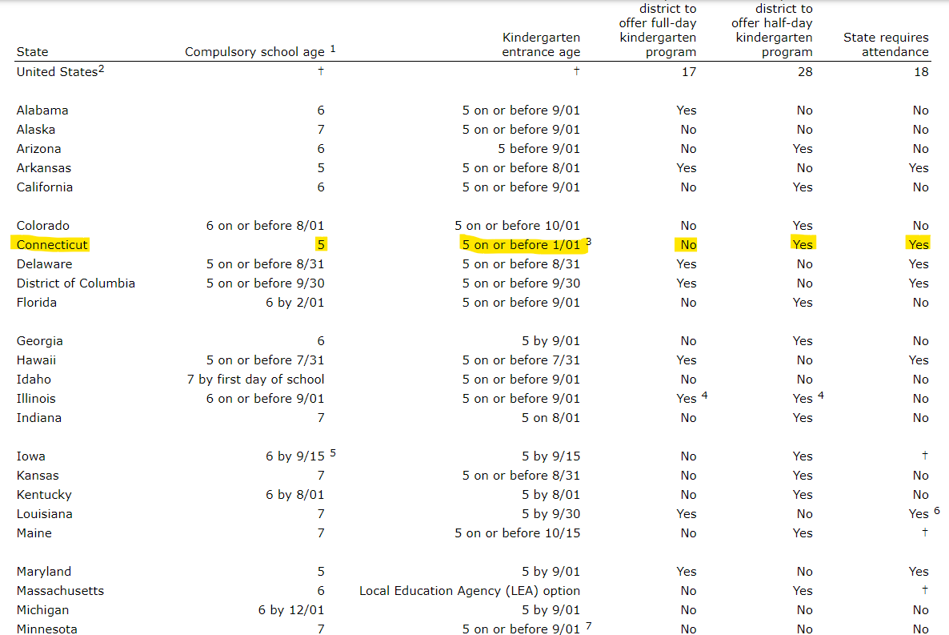
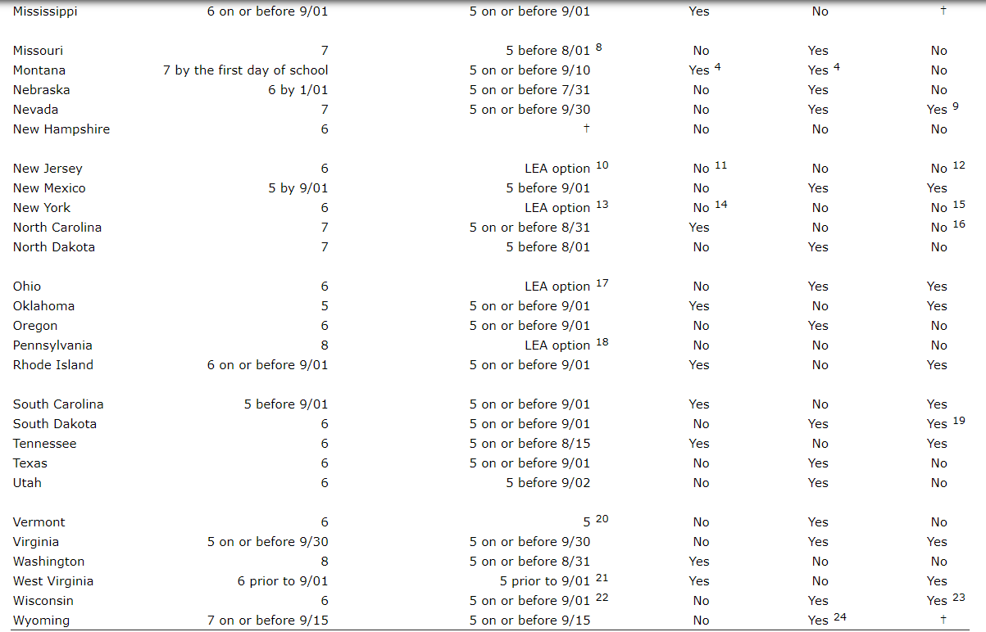
Step 1 Completed: Literature Review of The Problem
https://nces.ed.gov/programs/statereform/tab5_3.asp
“Ineffective transitions can result in higher stress levels for children and families, with lasting consequences for children’s adjustment to school. In contrast, effective transition supports help students and families productively engage in new school environments, contributing to children’s growth both academically and socially.” (Education Commission of the United States, 2021)
Notes:
What we know is that currently CT is the only state that accepts kindergarteners that are still 4 year-olds if they have a birthday before January 1st.
82% of other states have a cut off prior to 9/30, 4% have a cut off prior to 10/15 and remaining states 10% are Local Education Agency options New Hampshire has no data recorded and CT makes up 2% of a cut off of 1/1
Why is this cut off date important? Many children entering kindergarten may not be developmentally ready for the transition to a different school setting.
Factors may include limited preschool experience, developmental delays. Or needing more time to develop the executive functioning skills to be successful in a preschool setting.
Ineffective transitions can result in higher stress levels for children and families, with lasting consequences for children’s adjustment to school

Slide 3
What does current data show?
Step 1 Completed: Literature Review of The Problem
Since the late 1990s, Kindergarten has:
Increased attendance in full-day versus part-day classrooms.
Increased focus on academic content and decreased time spent on art, music and science.
Increased use of standardized tests.
(Education Commission of the United States, 2021)
“Recent research estimates that 72% of children may experience challenges with TTK, underscoring the critical importance of supporting children and families during this vulnerable period (Jiang et al., 2021).”
(Education Commission of the United States, 2021)
Notes:
We know that since the 1990s there has been a heavier focus on academic content and decreased focus on outlet based subjects such as music, art and science.
There is also increased use of standardized testing and curriculum unit assessments, adding more stress into the classroom.
Recent research from the Education Commission of the United States in 2021 reveals that 72% of children may experience challenges with transition to kindergarten.

Slide 4
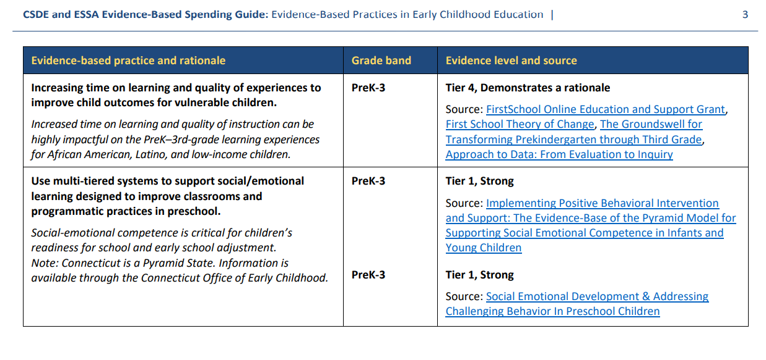
What does current data show?
Step 1 Completed: Literature Review of The Problem
Connecticut State Department of Education. (2018). CSDE and ESSA Evidence-Based Spending Guide.
Notes:
The Connecticut State Department of Education released an Evidence- Based practice guide- highlighting levels of evidence supporting well-designed and implemented randomized control experimental studies. Levels range from demonstrating a rationale to promising evidence, moderate evidence, and lastly- strong evidence.
One of the practices listed reads: using multi-tiered systems to support social/emotional learning designed to improve classrooms and programmatic practices in school.
The rationale is that social-emotional competence is critical for school readiness and the evidence level for this practice has the highest tier, strong.

Slide 5
Step 2 In Progress: The Proposal
Transitional Kindergarten Summer Program
“In a 2005 study on the effect of school-based kindergarten transition policies and practices on child academic outcomes, researchers established a link between the number of transition activities that schools facilitated prior to or near the beginning of kindergarten and larger gains in student academic achievement by the end of the year. This effect was strongest for students from low- and middle-socioeconomic status (SES) backgrounds.”
(Connecticut State Department of Education)
How can we support our youngest learners with their transition to kindergarten?
Notes:
Why is the transition to K important?
In a 2005 study from the CT Dep of Education, The number of transition activities that schools facilitated prior to or near the beginning of kindergarten and larger gains in student academic achievement by the end of the year.
Not only does data support it, but from first hand experience- I have witnessed the struggles of our youngest children in the classroom.
This can look like retaining students, referral to SRBI or intervention or behaviors in the classroom.
So what can we do to bridge this gap and support our youngest learners?

Slide 6

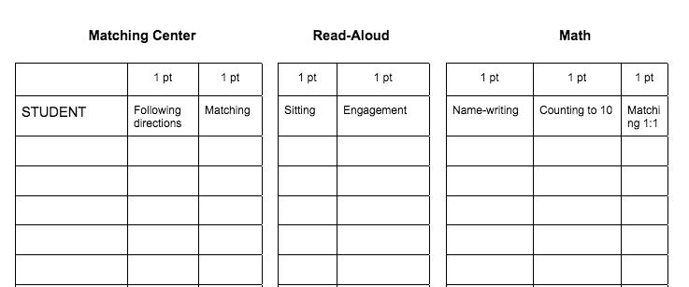
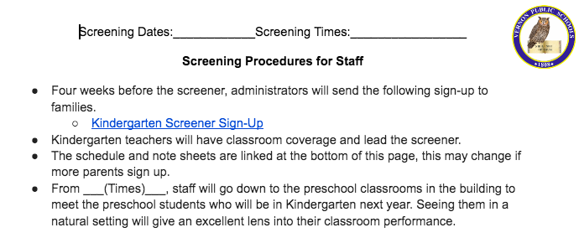
What are next steps?
Implement a transitional kindergarten summer program using the following criteria
Step 2 In Progress: The Proposal
Policy Revision | Vernon Public Schools | Instruction - Summer School 6174
The parent or responsible adult of a child five (5) years of age on or before the first day of January of any school year shall have the option of accepting a Transitional Kindergarten Summer Program spot if the child meets the following criteria.
Age eligible for Kindergarten (5 on or before January 1)
Birthday on or after September 1st
Limited Preschool experience or preschool recommendation supporting transitional kindergarten
Supportive Kindergarten Screening Data
Family survey input
*Screenshots of family survey, screening data collection, and staff communication
Notes:
My proposal is to adjust Vernon Public Schools summer school policy- Specifically instruction 6174.
I would like to propose a part-day summer program for a targeted group of children that must meet specific criteria to enter this program.
The summer program will include food, transportation and focus on integrating common core standards with a mix of early learning and development standards.
The policy will use the verbiage on this slide.
The parent or responsible adult of a child five (5) years of age on or before the first day of January of any school year shall have the option of accepting a Transitional Kindergarten Summer Program spot if the child meets the following criteria.
Age eligible for Kindergarten (5 on or before January 1)
Birthday on or after September 1st
Limited Preschool experience or preschool recommendation supporting transitional kindergarten
Supportive Kindergarten Screening Data
Family survey input
As mentioned, this program is targeting children that may need social emotional support along with activities to support the transition to kindergarten.
I have created resources like the family survey, screening information and data collection that would be ready to roll out upon approval.
I want to take it one step further and connect it to my current role as a child development teacher at the high school level.
I am proposing to use this summer program as an internship for high school students looking to enter the field of education. The program would run with a head teacher and high school students would apply for this program and volunteer service hours to support children. This could eliminate the cost of hiring paraprofessionals!

Slide 7
What are next steps?
Implement a transitional kindergarten summer program using the following criteria
Step 2 In Progress: The Proposal
Offer an internship opportunity for high school students that have taken childhood development and childhood education courses
This can look like community service hours or a small stipend
Students will apply and interview for the internship opportunity
This will replace the need for para support!

Slide 8

Step 2 In Progress: The Proposal
Level 1
Communicate with Stakeholders
Administrators
Program Coordinators
Superintendent
Building principal
Jason Magao
2/1/2023
Melissa Trantolo
Shelley McCone
2/1/2023
Dr. Joseph Macary
3/14/2023
Board of Education
3/27/2023
Hire summer program teacher by 6/1
Notes:
Level one of this proposal was to meet with my supervisors. I have also been in contact with program coordinators to assess costs and logistics.
I was informed that summer programming is at no cost this year and think this is an excellent opportunity to pilot this program.
The timeline is very fine so this could potentially be a project for next year, but with the knowledge of no cost, I would like to push this forward.
The goal is to implement the program this summer

Slide 9
Step 3-Next Steps: The Roll Out
Level 2
Communicate with Stakeholders
Principals
Kindergarten Teachers
Families
Send out screening invitations
4/30/2023
Host screening event
5/15/2023
Complete Family survey
5/15/2023
Contact recommended students list by 5/25/2023
Finalize summer roster 6/1/2023
Summer Program 6/27-7/28
Notes:
Level two of the proposal is to roll out the program plan to building principals , teachers and begin advertising to families.
Can’t speak for all schools, but I know that kindergarten screens students in May at CRS.
Families would be contact by 5/25
A finalized list would be approved by 6/1
We would align with summer program dates/times 6-22 to 7-78, Mon 8-12

Slide 10
Step 3-Next Steps: The Roll Out
Calculating The Cost
Summer learning is offered for free to recommended students for the 2023 school year because of grant funding.
This will be an excellent opportunity to pilot this program and measure success with the kindergarten entrance inventory (KEI).
Data may be taken during summer programming and again in the fall of 2024.
Possible costs for the future
Salary
Transportation
Curriculum/ Materials
Food
Notes:
Should this be a piloted program, we could focus on one school. And track the success of children using the KEI- Data can be taken with entry of the program and again in the fall with the typical date in October.
Should summer school need to be funded in future years- program costs may be supplies/ curriculum, food, transportation and salary.

Slide 11
Step 3-Next Steps: The Roll Out
Return on Investment
Decreased student referrals for behaviors
Increased academic outcomes
Goal:
The piloted summer program will prepare students for kindergarten
Decreased student retention requests
Increased school readiness as measured by Kindergarten Entrance Inventory
Decreased SRBI referrals for academics
Notes:
The goal of this proposed program is to decrease student retention, academic referrals, behavioral referrals leading to an increase in school readiness and academic outcome.
I would like to close by tying in the district's mission statement
The program would provide a quality education, with high expectations, in a safe environment where all students become independent learners and productive contributors to society.
The transitional kindergarten summer program ties into the goals directly.
1. Build and improve relationships and partnerships with family and community.
2. Increase the achievement of every student through high quality curriculum, instruction and assessment.
3. Promote safe environments that are socially, emotionally, and physically conducive to learning.
I look forward to your feedback and support in moving forward with this opportunity to support our youngest learners!

Slide 12
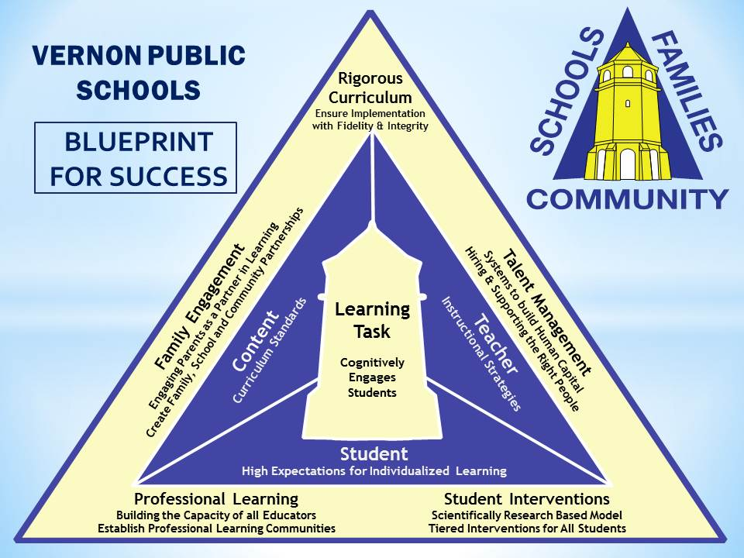
Putting it all Together
The Vernon Public Schools, in partnership with family and community, is committed to provide a quality education, with high expectations, in a safe environment where all students become independent learners and productive contributors to society.
Goals:
1. Build and improve relationships and partnerships with family and community.
2. Increase the achievement of every student through high quality curriculum, instruction and assessment.
3. Promote safe environments that are socially, emotionally, and physically conducive to learning.

